Slide 1

Continental-Scale Bayesian Analysis of Acacia Flowering Phenology A Novel Framework Integrating Phylogenetic Signal and Circular Statistics
Owen Forbes | Andrew Young | Peter Thrall
Biometrics in the Bush Capital
November 27, 2025

Slide 2

I would like to begin by acknowledging the Ngunnawal & Ngambri Peoples as the Traditional Owners of the land that we are gathered on, and pay my respect to their Elders past and present.
‘Eternal Wisdom, Infinite Innovation’ artwork by Rachael Sarra, working with Gilimbaa.
Notes:
Source: https://my.csiro.au/Working/Diversity-and-Inclusion/Indigenous-engagement/Resources
‘Eternal Wisdom, Infinite Innovation’ artwork by Rachael Sarra, working with Gilimbaa.
NOTE: Please do not use the RAP artwork for any other purpose than this acknowledgement slide.
All other uses need to be approved by the Indigenous Engagement team (OfficeofIndigenousEngagement@csiro.au)

Slide 3
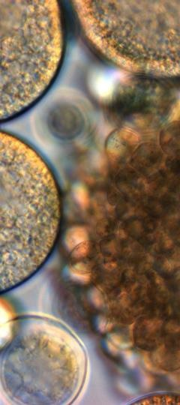
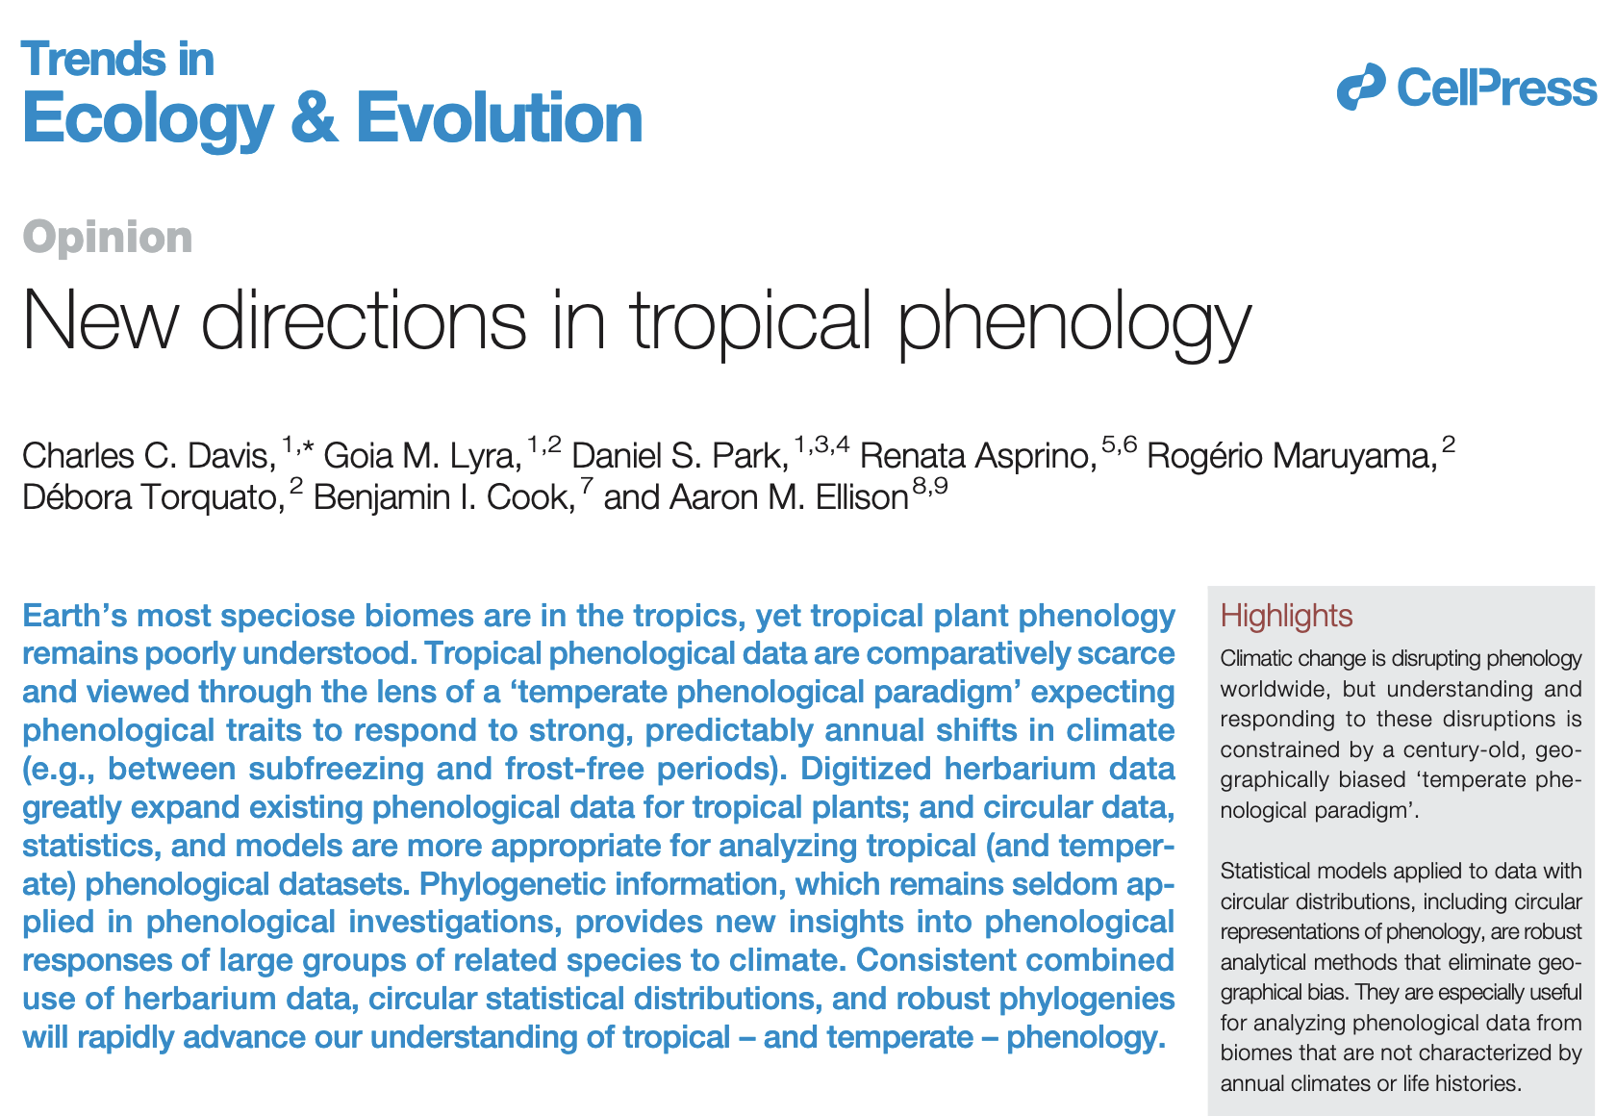
Phenology & Climate Research – what’s missing?
Documented shifts globally, but mostly focused on Northern temperate systems
Limited continental-scale, multi-species analyses
Few studies combine temporal depth with broad spatial extent
Lack of robust statistical approaches for complex phenological data
Circular outcome variables
Accounting for evolutionary relatedness (phylogenetic trees)
Southern hemisphere systems underrepresented
Notes:
Organisations, large and small, capitalise on our solutions as catalysts for growth. Spanning a range of scientific disciplines across the various stages of the innovation lifecycle, we apply our research to inform policy, develop new industries and evolve existing sectors ensuring success into the future.​
​
Sources: https://www.csiro.au/en/work-with-us ​
​
Industry-focused research and development: www.csiro.au/en/work-with-us/services/research-and-development ​
IP and Commercialisation: www.csiro.au/en/work-with-us/ip-commercialisation​
Funding and programs: www.csiro.au/en/work-with-us/funding-programs​
Commercial innovation services: www.csiro.au/en/work-with-us/ip-commercialisation​
Use our labs and facilities: www.csiro.au/en/work-with-us/use-our-labs-facilities​
Global collaboration: www.csiro.au/en/work-with-us/international ​

Slide 4
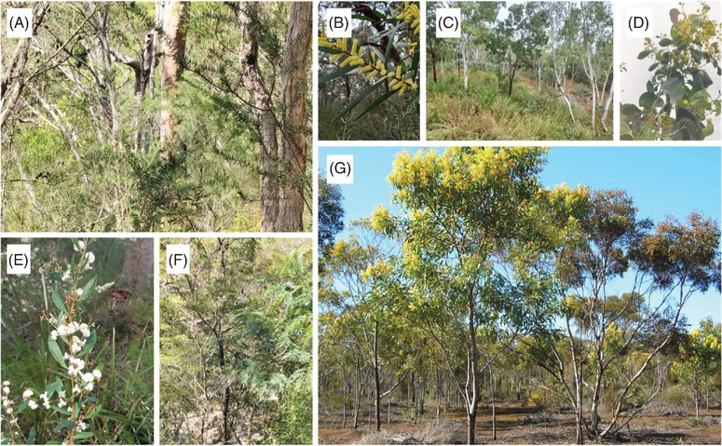
Why Acacias?
Australia’s Ecological Workhorses
900+ species across every Australian ecosystem - largest and most widespread genus of plants in the Australian flora
Nitrogen fixation and soil health
Critical for restoration efforts and biodiversity maintenance
Diverse invasion biology globally
Richardson, D. M., Marchante, E., & Le Roux, J. J. (2023). Australian acacia species around the world: historical, social, evolutionary and ecological insights into one of the planet’s most widespread plant genera. In Wattles: Australian Acacia Species Around the World (pp. 1-26). GB: CABI.
Notes:
Organisations, large and small, capitalise on our solutions as catalysts for growth. Spanning a range of scientific disciplines across the various stages of the innovation lifecycle, we apply our research to inform policy, develop new industries and evolve existing sectors ensuring success into the future.​
​
Sources: https://www.csiro.au/en/work-with-us ​
​
Industry-focused research and development: www.csiro.au/en/work-with-us/services/research-and-development ​
IP and Commercialisation: www.csiro.au/en/work-with-us/ip-commercialisation​
Funding and programs: www.csiro.au/en/work-with-us/funding-programs​
Commercial innovation services: www.csiro.au/en/work-with-us/ip-commercialisation​
Use our labs and facilities: www.csiro.au/en/work-with-us/use-our-labs-facilities​
Global collaboration: www.csiro.au/en/work-with-us/international ​

Slide 5
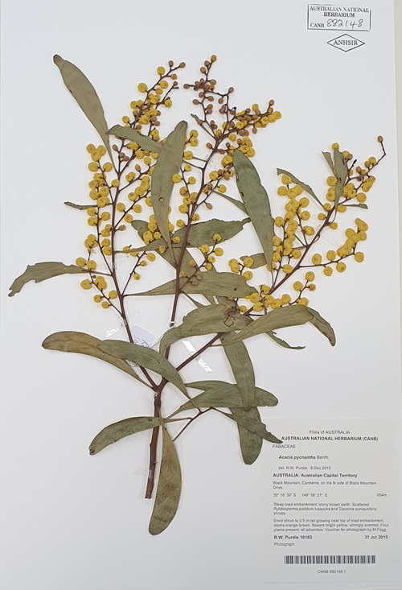
Herbaria + Natural History Collections at Scale
Australasian Virtual Herbarium
270,000+ records
75,000+ with flowering described
Under-utilised in phenological research
For our study:
20,950 herbarium specimens
‘flower*’; min. 3 per species X grid X year
548 Acacia species with phylogeny
110 years of data (1911-2020)
Aligning with AGCD v2
Continental coverage via 100×100km grid system
Notes:
Organisations, large and small, capitalise on our solutions as catalysts for growth. Spanning a range of scientific disciplines across the various stages of the innovation lifecycle, we apply our research to inform policy, develop new industries and evolve existing sectors ensuring success into the future.​
​
Sources: https://www.csiro.au/en/work-with-us ​
​
Industry-focused research and development: www.csiro.au/en/work-with-us/services/research-and-development ​
IP and Commercialisation: www.csiro.au/en/work-with-us/ip-commercialisation​
Funding and programs: www.csiro.au/en/work-with-us/funding-programs​
Commercial innovation services: www.csiro.au/en/work-with-us/ip-commercialisation​
Use our labs and facilities: www.csiro.au/en/work-with-us/use-our-labs-facilities​
Global collaboration: www.csiro.au/en/work-with-us/international ​

Slide 6
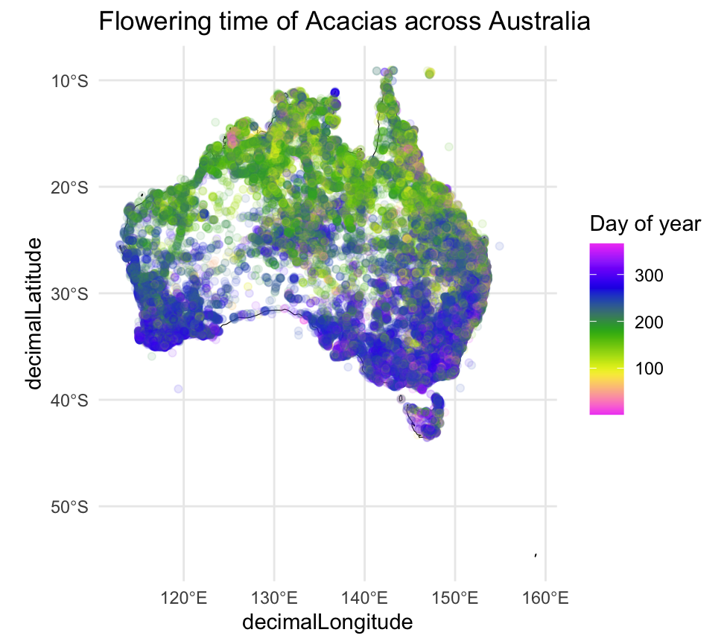
Our Modelling Approach
Bayesian hierarchical modelling @ continental scale
20,950 specimens across Australia, 5,259 flowering time estimates after filtering
548 species
1910-2020
Predictors for flowering time:
Local climate drivers (temperature, rainfall)
Climate zones (Köppen)
Day length (control covariate)
Phylogenetic covariance
Calendar year
Spatial autocorrelation

Slide 7
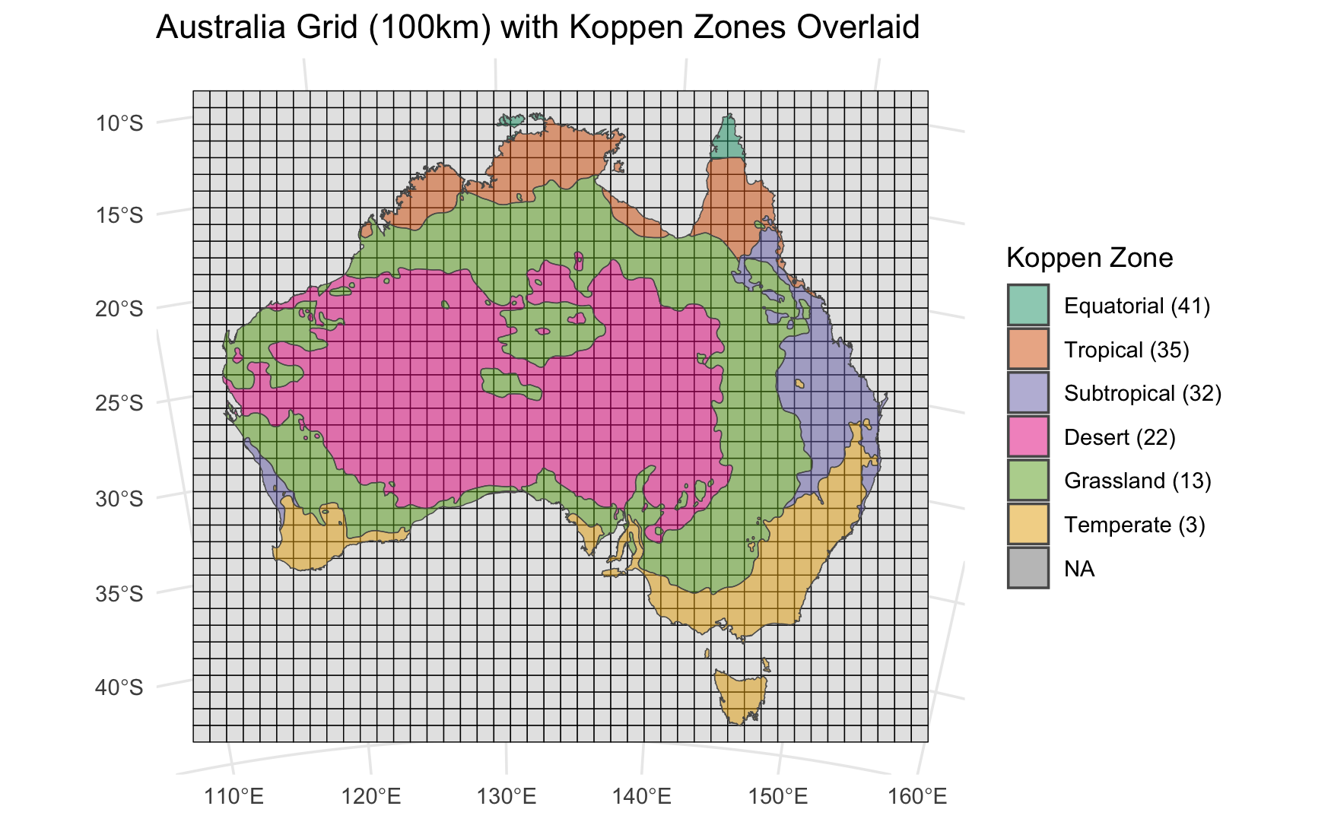
Our Modelling Approach
Bayesian hierarchical modelling @ continental scale
20,950 specimens across Australia, 5,259 flowering time estimates after filtering
548 species
1910-2020
Predictors for flowering time:
Local climate drivers (temperature, rainfall)
Climate zones (Köppen)
Day length (control covariate)
Phylogenetic covariance
Calendar year
Spatial autocorrelation

Slide 8
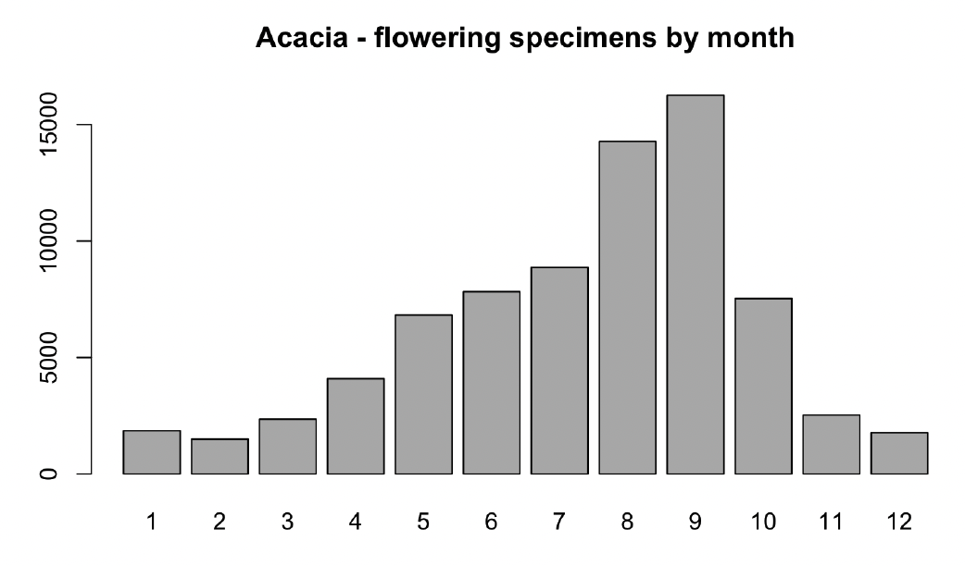
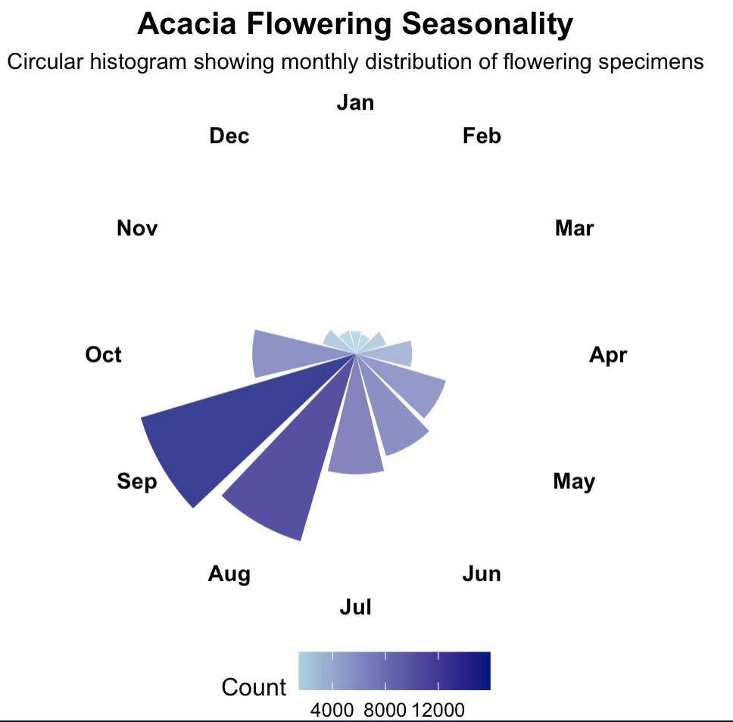
The Circular Data Challenge
Why Standard Statistics Fail
Day of year is circular: day 366/367 = day 1
Linear models miss seasonal wraparound effects
OK assumption on smaller local scales
Normal distributions can predict impossible values (<0, >365)
Inappropriate representation of distances
Representation of flowering year-round
--> Need circular statistics approach
Notes:
Organisations, large and small, capitalise on our solutions as catalysts for growth. Spanning a range of scientific disciplines across the various stages of the innovation lifecycle, we apply our research to inform policy, develop new industries and evolve existing sectors ensuring success into the future.​
​
Sources: https://www.csiro.au/en/work-with-us ​
​
Industry-focused research and development: www.csiro.au/en/work-with-us/services/research-and-development ​
IP and Commercialisation: www.csiro.au/en/work-with-us/ip-commercialisation​
Funding and programs: www.csiro.au/en/work-with-us/funding-programs​
Commercial innovation services: www.csiro.au/en/work-with-us/ip-commercialisation​
Use our labs and facilities: www.csiro.au/en/work-with-us/use-our-labs-facilities​
Global collaboration: www.csiro.au/en/work-with-us/international ​

Slide 9
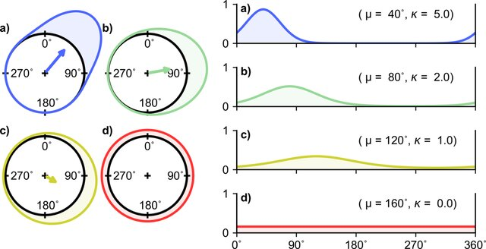
Von Mises Distributions
Circular analogue of normal/ Gaussian distribution
Parameters: μ (mean direction), κ (concentration)
Natural for periodic phenomena
Handles seasonal data appropriately
Easily implemented as a model family in {brms}
Notes:
Organisations, large and small, capitalise on our solutions as catalysts for growth. Spanning a range of scientific disciplines across the various stages of the innovation lifecycle, we apply our research to inform policy, develop new industries and evolve existing sectors ensuring success into the future.​
​
Sources: https://www.csiro.au/en/work-with-us ​
​
Industry-focused research and development: www.csiro.au/en/work-with-us/services/research-and-development ​
IP and Commercialisation: www.csiro.au/en/work-with-us/ip-commercialisation​
Funding and programs: www.csiro.au/en/work-with-us/funding-programs​
Commercial innovation services: www.csiro.au/en/work-with-us/ip-commercialisation​
Use our labs and facilities: www.csiro.au/en/work-with-us/use-our-labs-facilities​
Global collaboration: www.csiro.au/en/work-with-us/international ​

Slide 10
Preliminary Analyses
Variable selection – random forests
Phylogenetic Signal

Slide 11
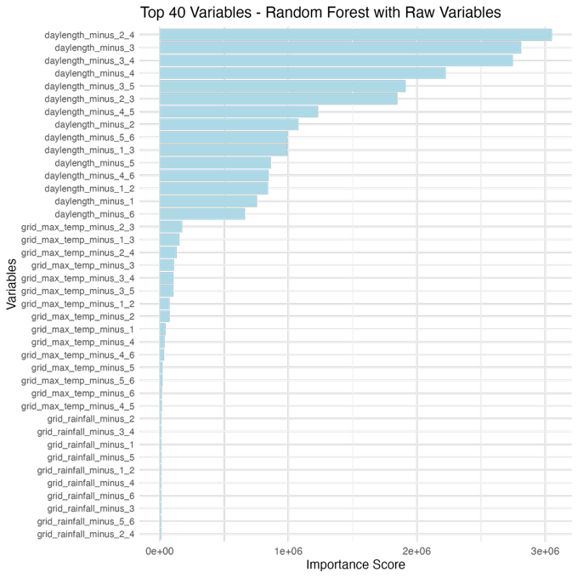
Variable Selection
Choose appropriate timing lags for rainfall, temperature and daylength, accounting for spatial variation in flowering time
Typically pinned to specific seasonal timing at local scale
Random forests + variable importance
Rolling windows – 1-, 2-, 3-month periods over 6 months prior to flowering
Anchored relative to average flowering month for each 100km grid
Daylength: Average, 3 months prior
Rainfall: Cumulative, 3-4 months prior
Temperature: Average max, 2-3 months prior
Notes:
Organisations, large and small, capitalise on our solutions as catalysts for growth. Spanning a range of scientific disciplines across the various stages of the innovation lifecycle, we apply our research to inform policy, develop new industries and evolve existing sectors ensuring success into the future.​
​
Sources: https://www.csiro.au/en/work-with-us ​
​
Industry-focused research and development: www.csiro.au/en/work-with-us/services/research-and-development ​
IP and Commercialisation: www.csiro.au/en/work-with-us/ip-commercialisation​
Funding and programs: www.csiro.au/en/work-with-us/funding-programs​
Commercial innovation services: www.csiro.au/en/work-with-us/ip-commercialisation​
Use our labs and facilities: www.csiro.au/en/work-with-us/use-our-labs-facilities​
Global collaboration: www.csiro.au/en/work-with-us/international ​

Slide 12
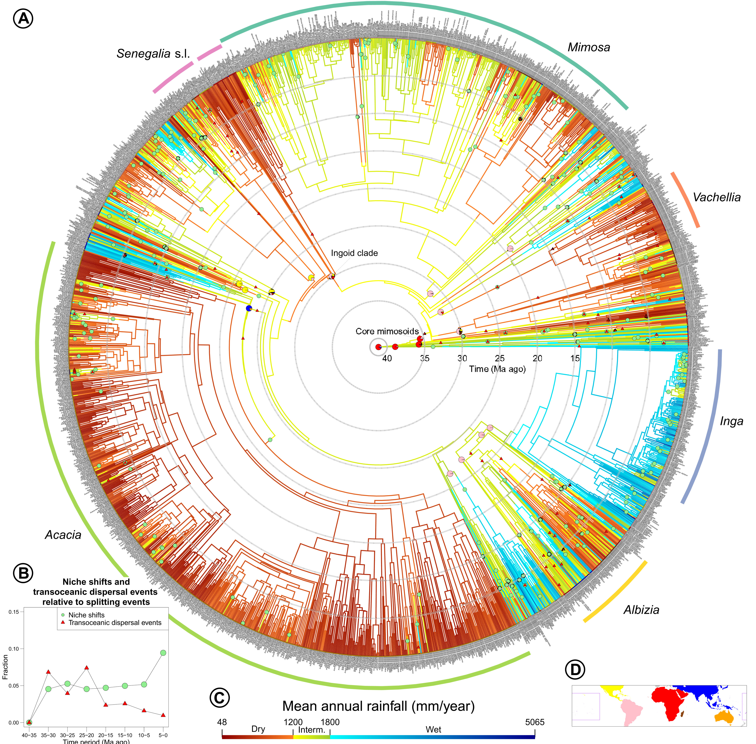
Phylogenetic Signal
Tests to see whether variation in flowering time is greater than expected by chance in more genetically similar species
Phytools::phylosig()
Acacia flowering time:
Blomberg’s K = 0.280 (p = 0.001)
Initial indication: moderate phylogenetic signal = motivates inclusion of phylogenetic structure in main model
Incorporated in Bayesian hierarchical model
Phylogenetic covariance on residuals of species random effect
Extension of Phylogenetic Least Squares methodology to flexible & modular Bayesian setting
Ringelberg, J. J., Koenen, E. J., Sauter, B., Aebli, A., Rando, J. G., Iganci, J. R., ... & Hughes, C. E. (2023). Precipitation is the main axis of tropical plant phylogenetic turnover across space and time. Science Advances, 9(7), eade4954.
Notes:
Organisations, large and small, capitalise on our solutions as catalysts for growth. Spanning a range of scientific disciplines across the various stages of the innovation lifecycle, we apply our research to inform policy, develop new industries and evolve existing sectors ensuring success into the future.​
​
Sources: https://www.csiro.au/en/work-with-us ​
​
Industry-focused research and development: www.csiro.au/en/work-with-us/services/research-and-development ​
IP and Commercialisation: www.csiro.au/en/work-with-us/ip-commercialisation​
Funding and programs: www.csiro.au/en/work-with-us/funding-programs​
Commercial innovation services: www.csiro.au/en/work-with-us/ip-commercialisation​
Use our labs and facilities: www.csiro.au/en/work-with-us/use-our-labs-facilities​
Global collaboration: www.csiro.au/en/work-with-us/international ​

Slide 13
Primary Analyses
Bayesian Model Specification Model Comparison

Slide 14
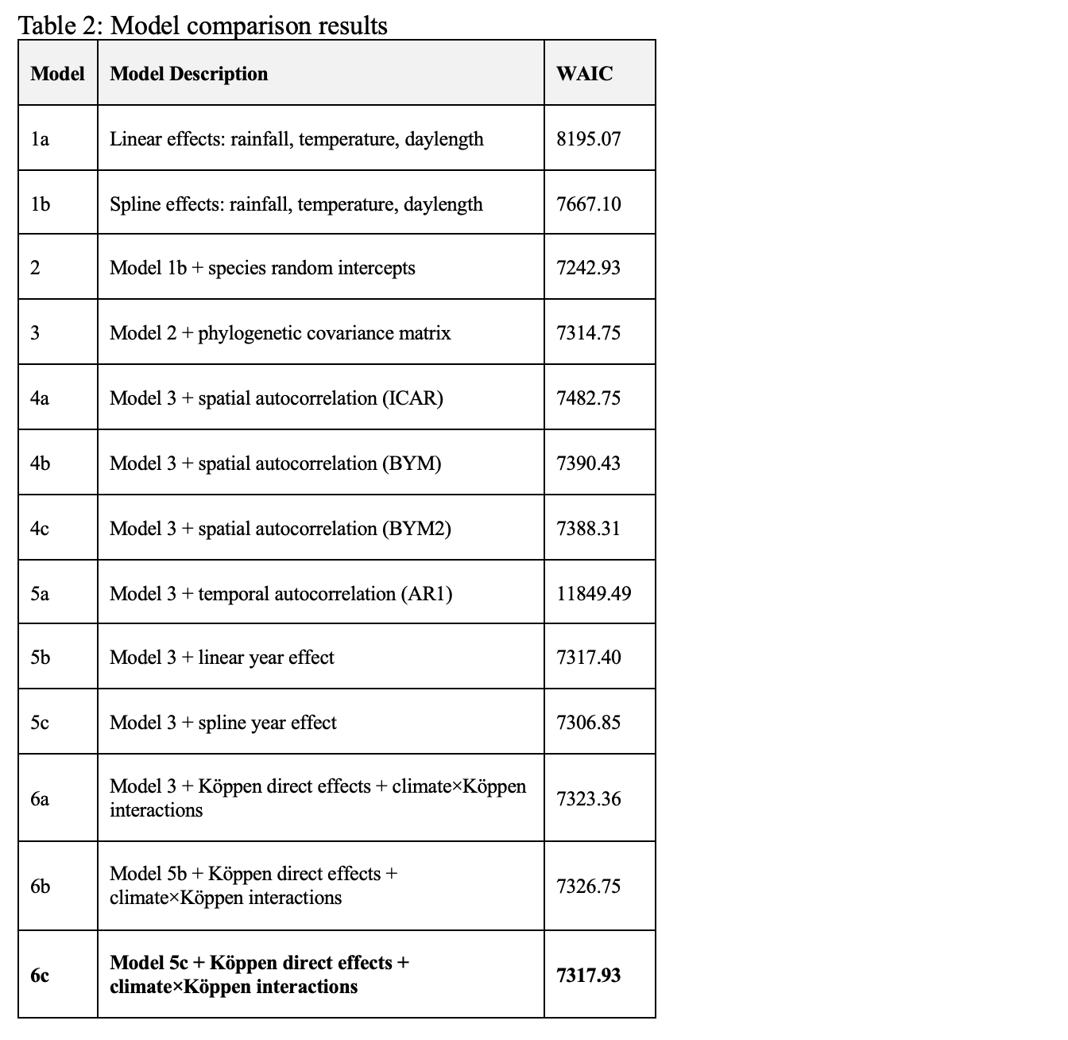
Model Specification & Comparison
Started simple: Linear climate + daylength effects (WAIC = 8195)
Added non-linear spline effects: Massive improvement (WAIC = 7667)
Species random effects: Further improvement (WAIC = 7243)
Phylogenetic structure: Retained for biological realism & scientific questions of interest (WAIC = 7315)
Spatial autocorrelation: no improvement
Temporal trend – spline on calendar year: improvement (WAIC = 7307)
Köppen zone direct & interactions – key interpretability: Final model (WAIC = 7318)
Notes:
Organisations, large and small, capitalise on our solutions as catalysts for growth. Spanning a range of scientific disciplines across the various stages of the innovation lifecycle, we apply our research to inform policy, develop new industries and evolve existing sectors ensuring success into the future.​
​
Sources: https://www.csiro.au/en/work-with-us ​
​
Industry-focused research and development: www.csiro.au/en/work-with-us/services/research-and-development ​
IP and Commercialisation: www.csiro.au/en/work-with-us/ip-commercialisation​
Funding and programs: www.csiro.au/en/work-with-us/funding-programs​
Commercial innovation services: www.csiro.au/en/work-with-us/ip-commercialisation​
Use our labs and facilities: www.csiro.au/en/work-with-us/use-our-labs-facilities​
Global collaboration: www.csiro.au/en/work-with-us/international ​

Slide 15
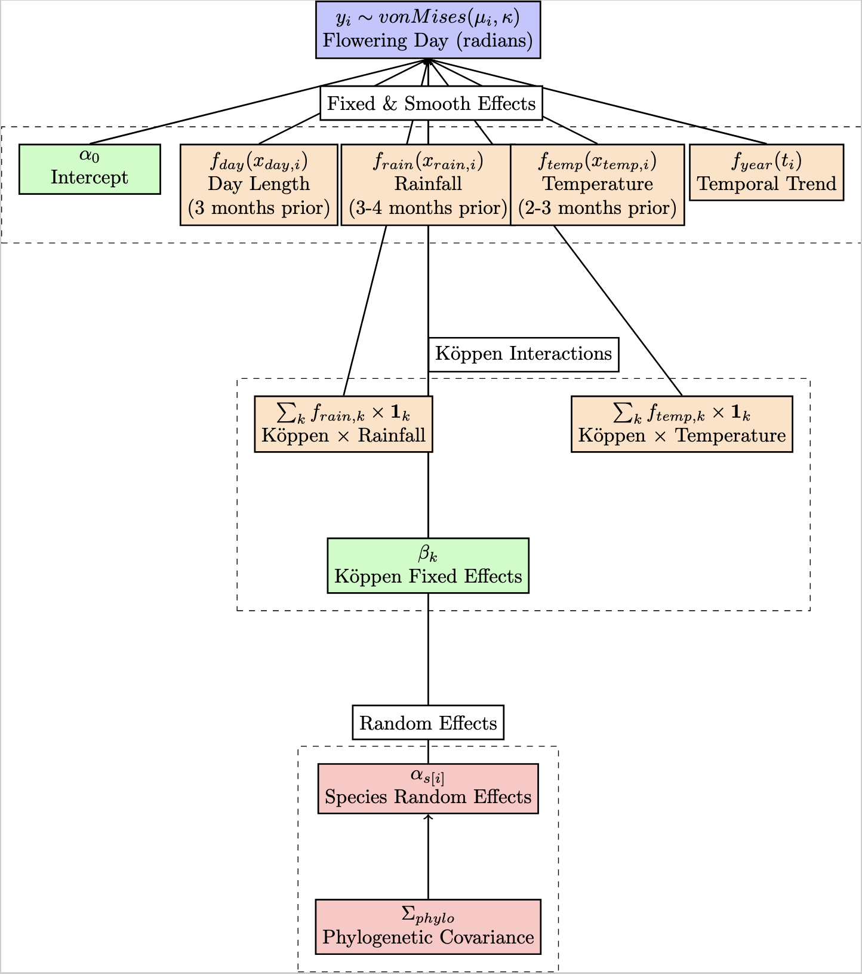
Final Model Structure
Von Mises family for day-of-year data
DOY converted to radians [0, 2π]
Non-linear climate effects (splines)
Cumulative Rainfall 3-4 months prior; Max Temp 2-3 months prior
Daylength 3 months prior
Temporal trend (calendar year – spline effect)
Köppen zone-specific climate responses (direct & interaction effects)
Species random effects with phylogenetic covariance matrix on residuals
Spatial autocorrelation tested but not retained
Notes:
Organisations, large and small, capitalise on our solutions as catalysts for growth. Spanning a range of scientific disciplines across the various stages of the innovation lifecycle, we apply our research to inform policy, develop new industries and evolve existing sectors ensuring success into the future.​
​
Sources: https://www.csiro.au/en/work-with-us ​
​
Industry-focused research and development: www.csiro.au/en/work-with-us/services/research-and-development ​
IP and Commercialisation: www.csiro.au/en/work-with-us/ip-commercialisation​
Funding and programs: www.csiro.au/en/work-with-us/funding-programs​
Commercial innovation services: www.csiro.au/en/work-with-us/ip-commercialisation​
Use our labs and facilities: www.csiro.au/en/work-with-us/use-our-labs-facilities​
Global collaboration: www.csiro.au/en/work-with-us/international ​

Slide 16
Key Findings

Slide 17
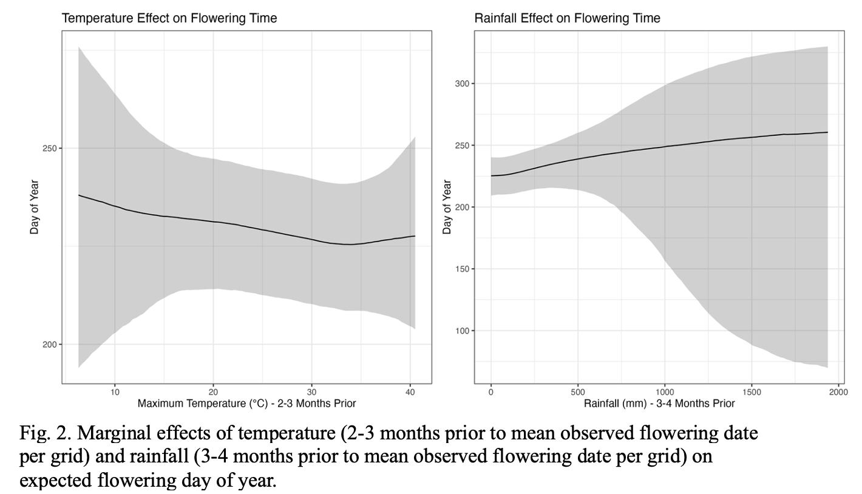
Overall Climate Effects
Continental-Scale Patterns
Higher temperature → earlier flowering (non-linear)
Higher rainfall → later flowering (non-linear)
Strong non-linear relationships
Uncertainty increases outside observed ranges
Notes:
Organisations, large and small, capitalise on our solutions as catalysts for growth. Spanning a range of scientific disciplines across the various stages of the innovation lifecycle, we apply our research to inform policy, develop new industries and evolve existing sectors ensuring success into the future.​
​
Sources: https://www.csiro.au/en/work-with-us ​
​
Industry-focused research and development: www.csiro.au/en/work-with-us/services/research-and-development ​
IP and Commercialisation: www.csiro.au/en/work-with-us/ip-commercialisation​
Funding and programs: www.csiro.au/en/work-with-us/funding-programs​
Commercial innovation services: www.csiro.au/en/work-with-us/ip-commercialisation​
Use our labs and facilities: www.csiro.au/en/work-with-us/use-our-labs-facilities​
Global collaboration: www.csiro.au/en/work-with-us/international ​

Slide 18
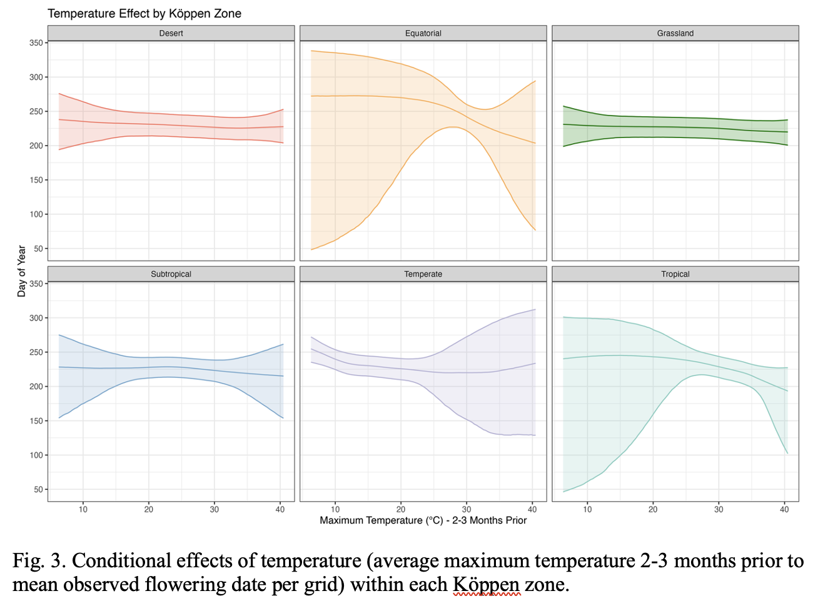
Köppen Climate Zone Differences - Temperature
Temperature Sensitivity Varies by Köppen Zone
Highest sensitivity: Temperate, Tropical, Equatorial
Moderate sensitivity: Desert
Lowest sensitivity: Grassland, Subtropical
Non-linear responses throughout
Notes:
Organisations, large and small, capitalise on our solutions as catalysts for growth. Spanning a range of scientific disciplines across the various stages of the innovation lifecycle, we apply our research to inform policy, develop new industries and evolve existing sectors ensuring success into the future.​
​
Sources: https://www.csiro.au/en/work-with-us ​
​
Industry-focused research and development: www.csiro.au/en/work-with-us/services/research-and-development ​
IP and Commercialisation: www.csiro.au/en/work-with-us/ip-commercialisation​
Funding and programs: www.csiro.au/en/work-with-us/funding-programs​
Commercial innovation services: www.csiro.au/en/work-with-us/ip-commercialisation​
Use our labs and facilities: www.csiro.au/en/work-with-us/use-our-labs-facilities​
Global collaboration: www.csiro.au/en/work-with-us/international ​

Slide 19
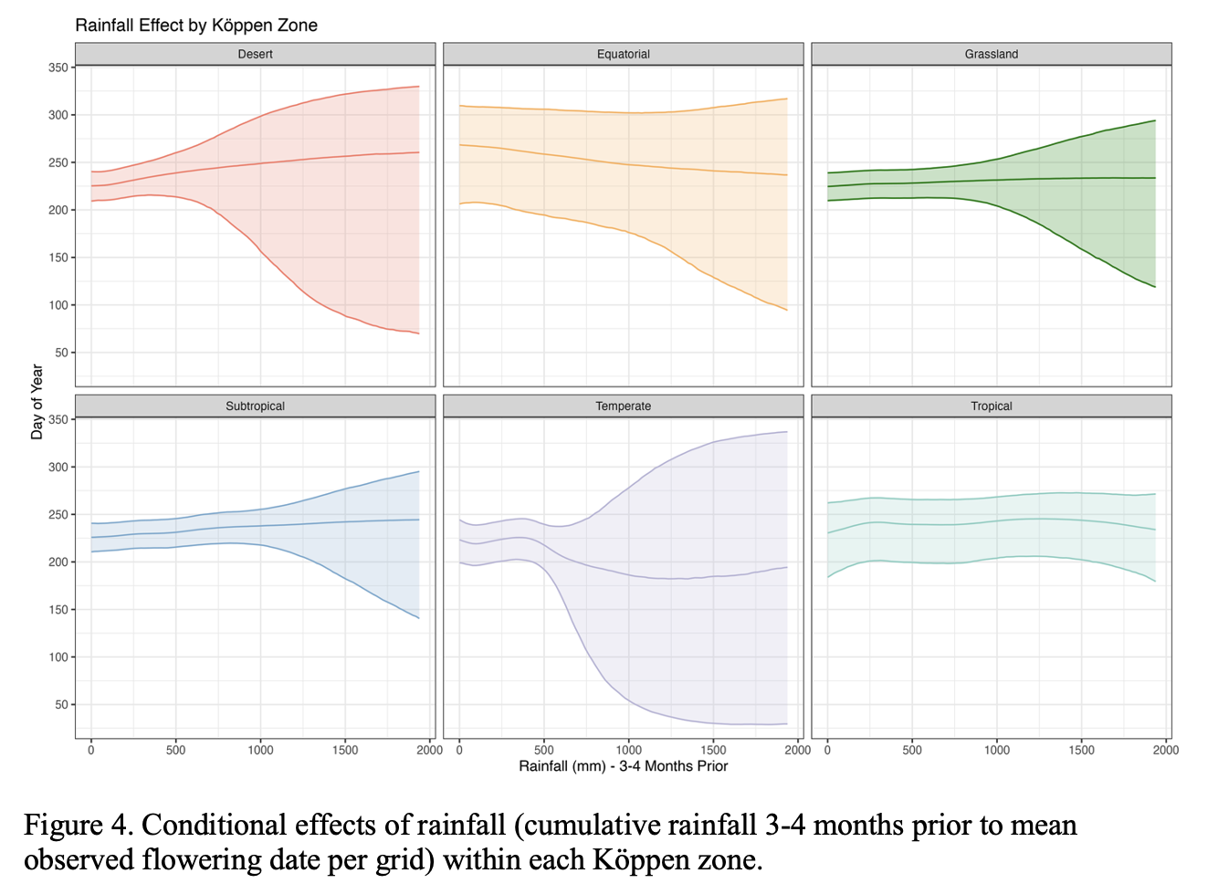
Köppen Climate Zone Differences - Rainfall
Rainfall Responses Show Unique Patterns
Most zones: more rain → later flowering
Equatorial exception: more rain → earlier flowering
(less data)
Highest sensitivity: Desert, Subtropical, Temperate
Complex non-linear relationships
Notes:
Organisations, large and small, capitalise on our solutions as catalysts for growth. Spanning a range of scientific disciplines across the various stages of the innovation lifecycle, we apply our research to inform policy, develop new industries and evolve existing sectors ensuring success into the future.​
​
Sources: https://www.csiro.au/en/work-with-us ​
​
Industry-focused research and development: www.csiro.au/en/work-with-us/services/research-and-development ​
IP and Commercialisation: www.csiro.au/en/work-with-us/ip-commercialisation​
Funding and programs: www.csiro.au/en/work-with-us/funding-programs​
Commercial innovation services: www.csiro.au/en/work-with-us/ip-commercialisation​
Use our labs and facilities: www.csiro.au/en/work-with-us/use-our-labs-facilities​
Global collaboration: www.csiro.au/en/work-with-us/international ​

Slide 20
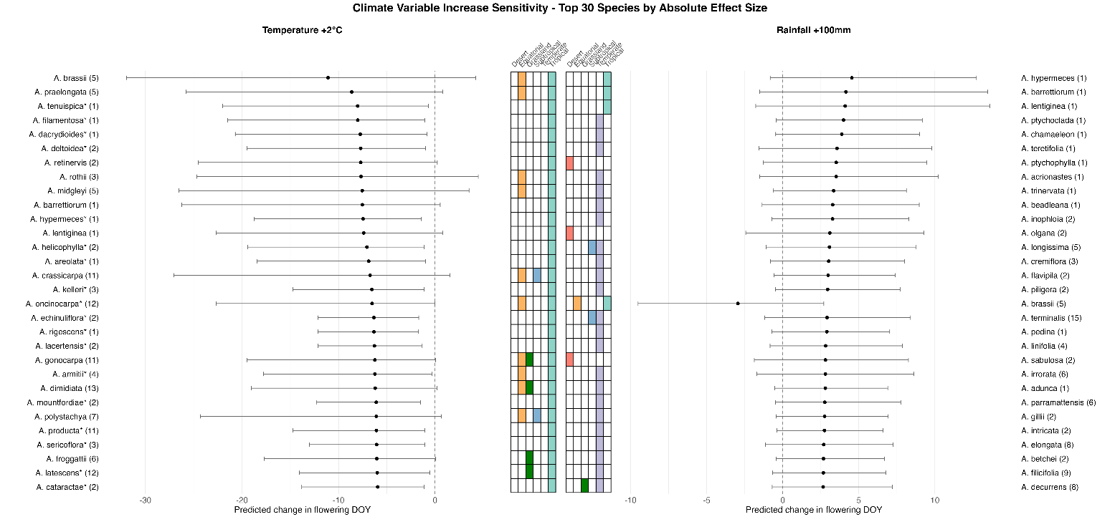
Species-Level Variation
Dramatic Differences Among Species
Temperature: some species expected shift >10 days per 2°C
Rainfall: responses range from -2.6 to +4.6 days per 100mm
Different species show diverse response patterns
Most sensitive species tend to have narrow ranges
Niche breadth-range size relationships (Slatyer et al 2013)
Notes:
Organisations, large and small, capitalise on our solutions as catalysts for growth. Spanning a range of scientific disciplines across the various stages of the innovation lifecycle, we apply our research to inform policy, develop new industries and evolve existing sectors ensuring success into the future.​
​
Sources: https://www.csiro.au/en/work-with-us ​
​
Industry-focused research and development: www.csiro.au/en/work-with-us/services/research-and-development ​
IP and Commercialisation: www.csiro.au/en/work-with-us/ip-commercialisation​
Funding and programs: www.csiro.au/en/work-with-us/funding-programs​
Commercial innovation services: www.csiro.au/en/work-with-us/ip-commercialisation​
Use our labs and facilities: www.csiro.au/en/work-with-us/use-our-labs-facilities​
Global collaboration: www.csiro.au/en/work-with-us/international ​

Slide 21
Species-Level Variation
Dramatic Differences Among Species
Temperature: some species expected shift >10 days per 2°C
Rainfall: responses range from -2.6 to +4.6 days per 100mm
Different species show diverse response patterns
Most sensitive species tend to have narrow ranges
Niche breadth-range size relationships (Slatyer et al 2013)
Notes:
Organisations, large and small, capitalise on our solutions as catalysts for growth. Spanning a range of scientific disciplines across the various stages of the innovation lifecycle, we apply our research to inform policy, develop new industries and evolve existing sectors ensuring success into the future.​
​
Sources: https://www.csiro.au/en/work-with-us ​
​
Industry-focused research and development: www.csiro.au/en/work-with-us/services/research-and-development ​
IP and Commercialisation: www.csiro.au/en/work-with-us/ip-commercialisation​
Funding and programs: www.csiro.au/en/work-with-us/funding-programs​
Commercial innovation services: www.csiro.au/en/work-with-us/ip-commercialisation​
Use our labs and facilities: www.csiro.au/en/work-with-us/use-our-labs-facilities​
Global collaboration: www.csiro.au/en/work-with-us/international ​

Slide 22
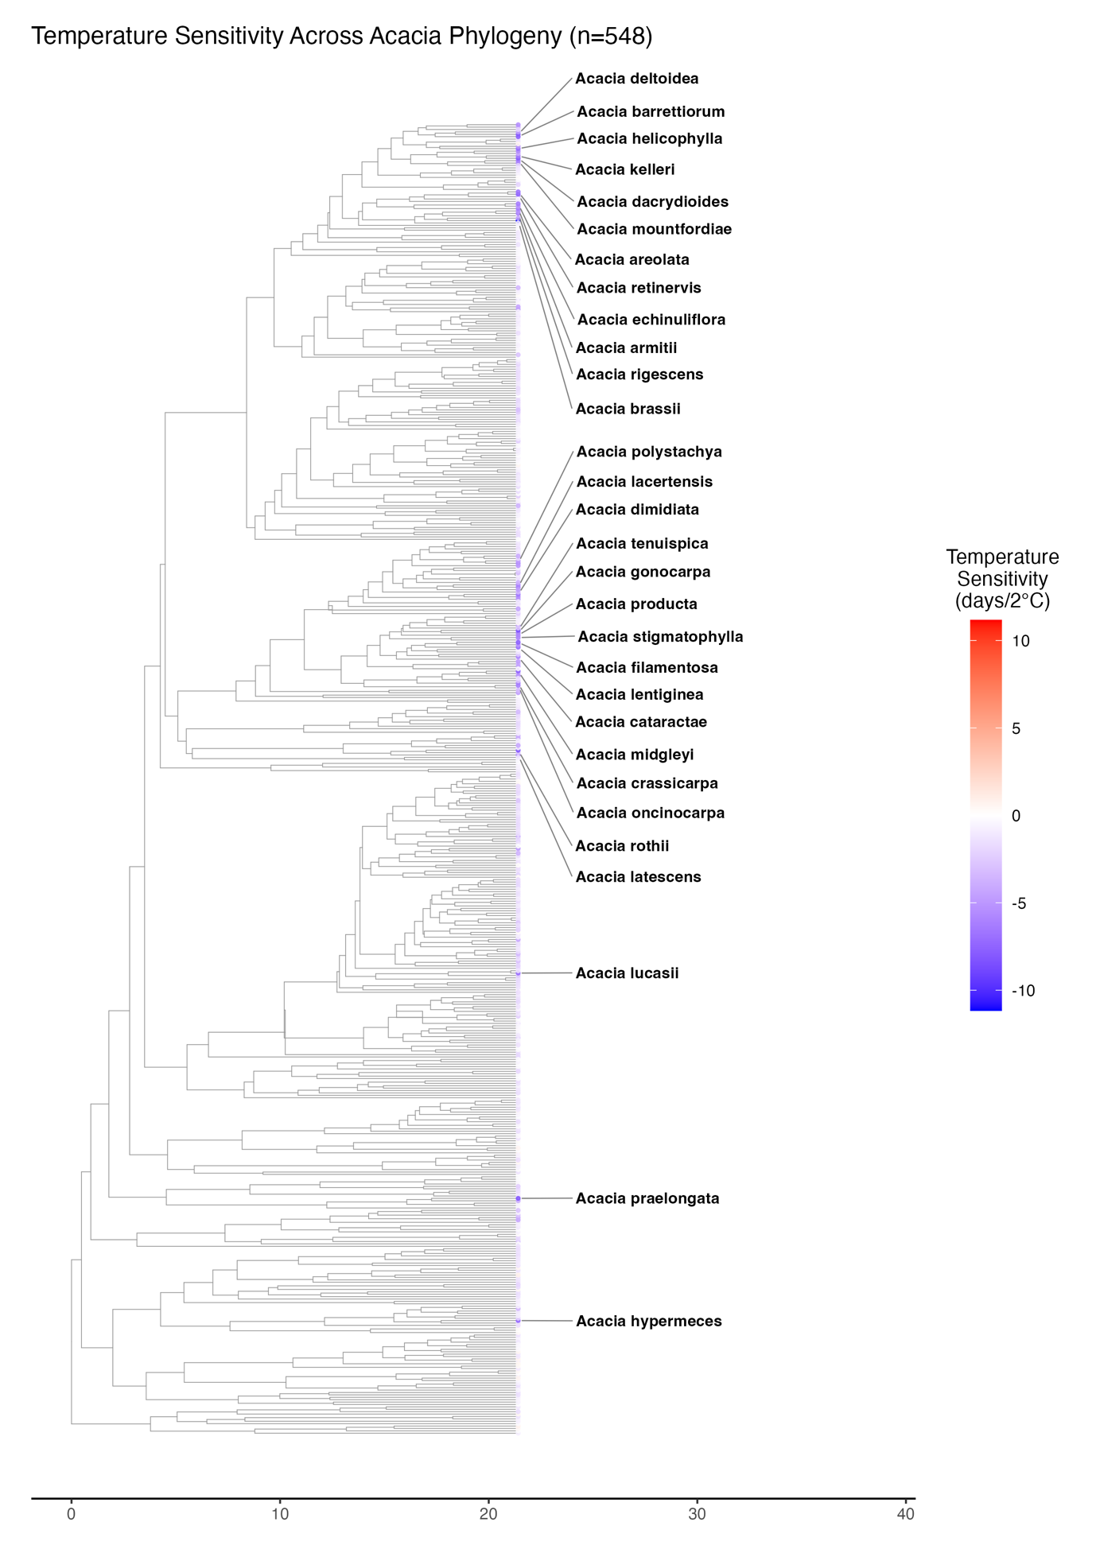
Phylogenetic Constraints
Evolution Shapes Climate Responses
Clear phylogenetic clustering in sensitivity
Related species show similar climate responses
Significant phylogenetic signals in temperature & rainfall sensitivity measures (Blomberg’s K = 0.20 – 0.42)
Implications for predicting responses in unstudied species
Notes:
Organisations, large and small, capitalise on our solutions as catalysts for growth. Spanning a range of scientific disciplines across the various stages of the innovation lifecycle, we apply our research to inform policy, develop new industries and evolve existing sectors ensuring success into the future.​
​
Sources: https://www.csiro.au/en/work-with-us ​
​
Industry-focused research and development: www.csiro.au/en/work-with-us/services/research-and-development ​
IP and Commercialisation: www.csiro.au/en/work-with-us/ip-commercialisation​
Funding and programs: www.csiro.au/en/work-with-us/funding-programs​
Commercial innovation services: www.csiro.au/en/work-with-us/ip-commercialisation​
Use our labs and facilities: www.csiro.au/en/work-with-us/use-our-labs-facilities​
Global collaboration: www.csiro.au/en/work-with-us/international ​

Slide 23
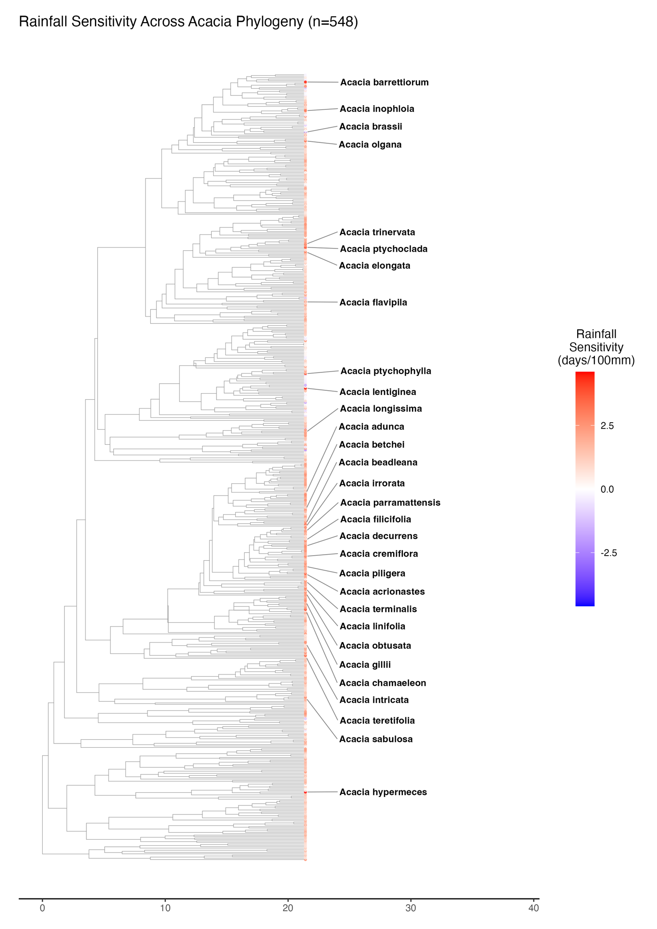
Phylogenetic Constraints
Evolution Shapes Climate Responses
Clear phylogenetic clustering in sensitivity
Related species show similar climate responses
Significant phylogenetic signals in temperature & rainfall sensitivity measures (Blomberg’s K = 0.28 – 0.42)
Implications for predicting responses in unstudied species
Notes:
Organisations, large and small, capitalise on our solutions as catalysts for growth. Spanning a range of scientific disciplines across the various stages of the innovation lifecycle, we apply our research to inform policy, develop new industries and evolve existing sectors ensuring success into the future.​
​
Sources: https://www.csiro.au/en/work-with-us ​
​
Industry-focused research and development: www.csiro.au/en/work-with-us/services/research-and-development ​
IP and Commercialisation: www.csiro.au/en/work-with-us/ip-commercialisation​
Funding and programs: www.csiro.au/en/work-with-us/funding-programs​
Commercial innovation services: www.csiro.au/en/work-with-us/ip-commercialisation​
Use our labs and facilities: www.csiro.au/en/work-with-us/use-our-labs-facilities​
Global collaboration: www.csiro.au/en/work-with-us/international ​

Slide 24
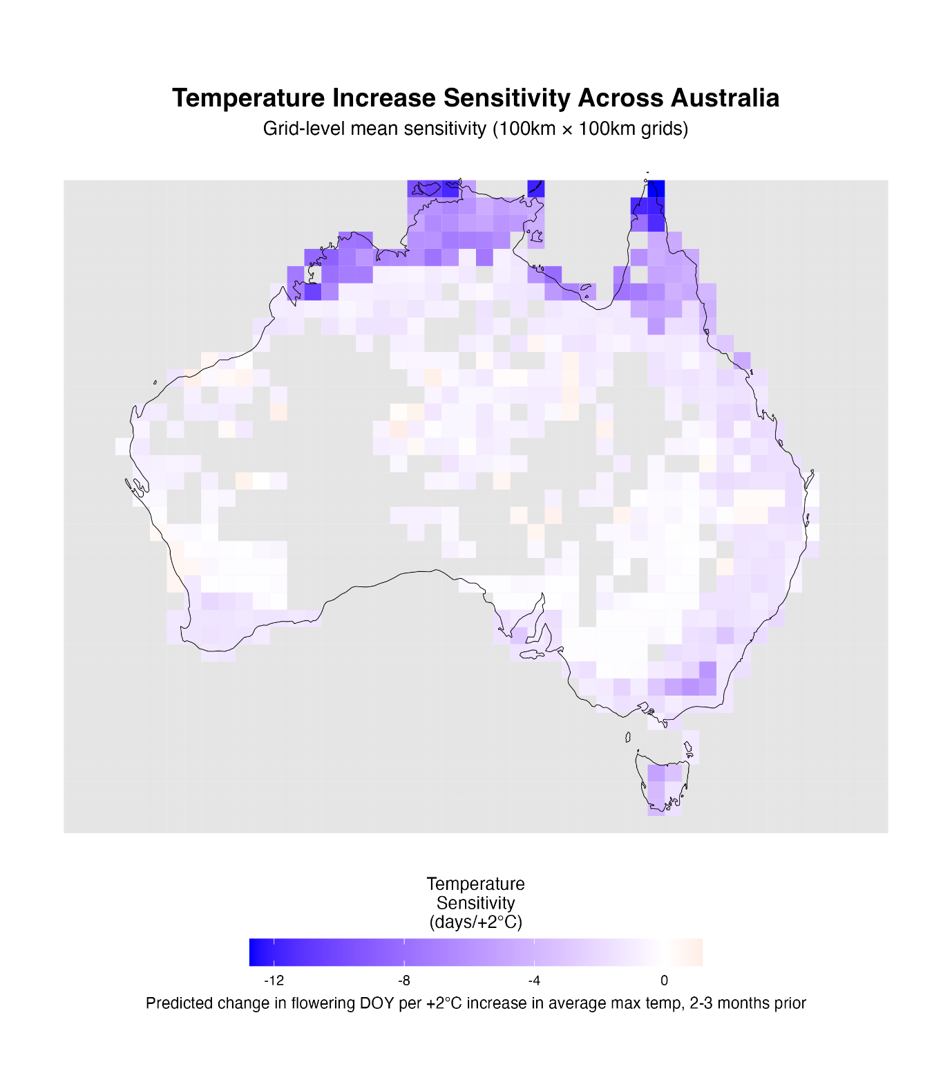
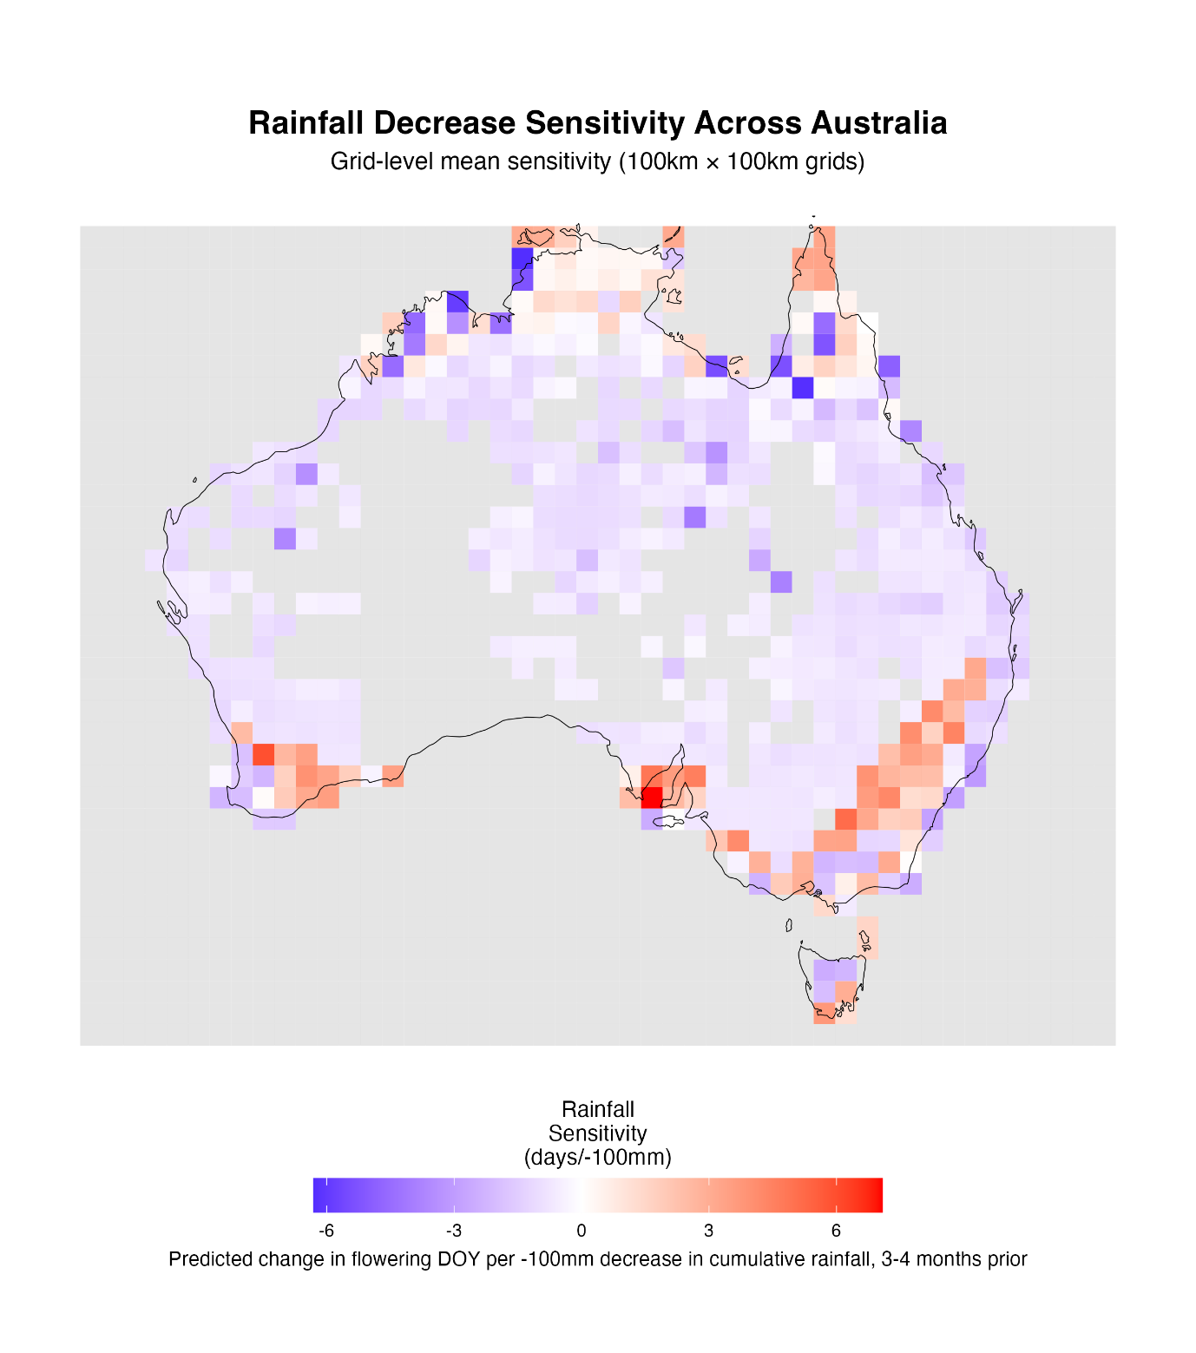
Spatial Patterns in Climate Sensitivity
Notes:
Organisations, large and small, capitalise on our solutions as catalysts for growth. Spanning a range of scientific disciplines across the various stages of the innovation lifecycle, we apply our research to inform policy, develop new industries and evolve existing sectors ensuring success into the future.​
​
Sources: https://www.csiro.au/en/work-with-us ​
​
Industry-focused research and development: www.csiro.au/en/work-with-us/services/research-and-development ​
IP and Commercialisation: www.csiro.au/en/work-with-us/ip-commercialisation​
Funding and programs: www.csiro.au/en/work-with-us/funding-programs​
Commercial innovation services: www.csiro.au/en/work-with-us/ip-commercialisation​
Use our labs and facilities: www.csiro.au/en/work-with-us/use-our-labs-facilities​
Global collaboration: www.csiro.au/en/work-with-us/international ​

Slide 25
Our methodological innovations
🤩 Circular statistics: Von Mises distributions handle day-of-year data appropriately
🆒 Bayesian hierarchical framework: Accounts for species, phylogenetic, and spatial structure
🎉 Phylogenetic covariance: Evolutionary relationships constrain climate responses
🫨 Continental-scale integration: 20,950 specimens across 110 years and 548 species
• Non-linear climate effects: Splines captured complex responses
• Multi-scale modelling: Köppen zones, temporal trends, and species-specific effects
• Natural history collections: Unparalleled temporal depth and spatial extent
Notes:
Organisations, large and small, capitalise on our solutions as catalysts for growth. Spanning a range of scientific disciplines across the various stages of the innovation lifecycle, we apply our research to inform policy, develop new industries and evolve existing sectors ensuring success into the future.​
​
Sources: https://www.csiro.au/en/work-with-us ​
​
Industry-focused research and development: www.csiro.au/en/work-with-us/services/research-and-development ​
IP and Commercialisation: www.csiro.au/en/work-with-us/ip-commercialisation​
Funding and programs: www.csiro.au/en/work-with-us/funding-programs​
Commercial innovation services: www.csiro.au/en/work-with-us/ip-commercialisation​
Use our labs and facilities: www.csiro.au/en/work-with-us/use-our-labs-facilities​
Global collaboration: www.csiro.au/en/work-with-us/international ​

Slide 26
Bonus slides

Slide 27
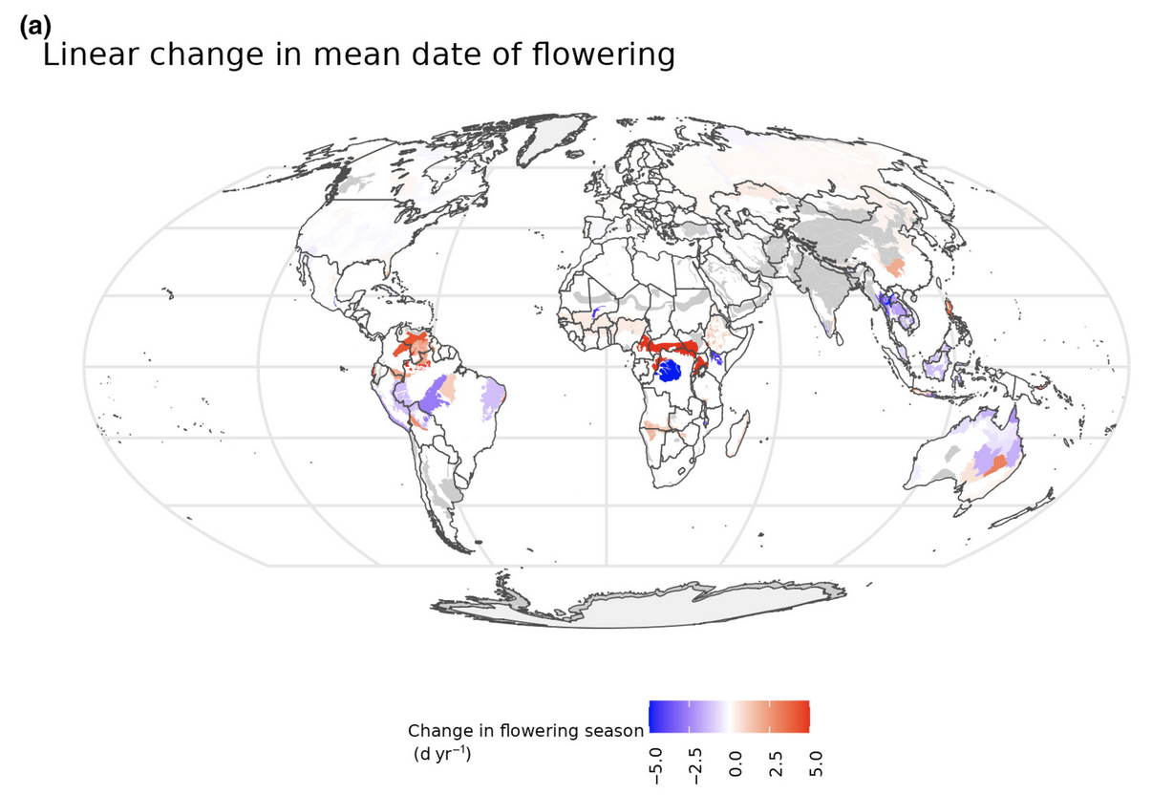
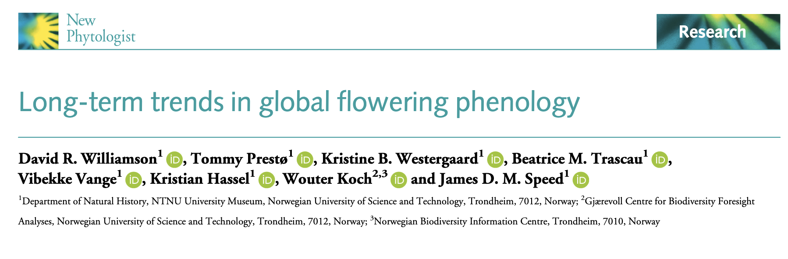
Plant Phenology and Climate Change
Documented shifts in flowering, leafing, fruiting globally in response to changes in climate drivers
Phenology timing = critical for ecosystem functioning and species interactions
Most research focused on northern temperate systems
Notes:
Organisations, large and small, capitalise on our solutions as catalysts for growth. Spanning a range of scientific disciplines across the various stages of the innovation lifecycle, we apply our research to inform policy, develop new industries and evolve existing sectors ensuring success into the future.​
​
Sources: https://www.csiro.au/en/work-with-us ​
​
Industry-focused research and development: www.csiro.au/en/work-with-us/services/research-and-development ​
IP and Commercialisation: www.csiro.au/en/work-with-us/ip-commercialisation​
Funding and programs: www.csiro.au/en/work-with-us/funding-programs​
Commercial innovation services: www.csiro.au/en/work-with-us/ip-commercialisation​
Use our labs and facilities: www.csiro.au/en/work-with-us/use-our-labs-facilities​
Global collaboration: www.csiro.au/en/work-with-us/international ​

Slide 28
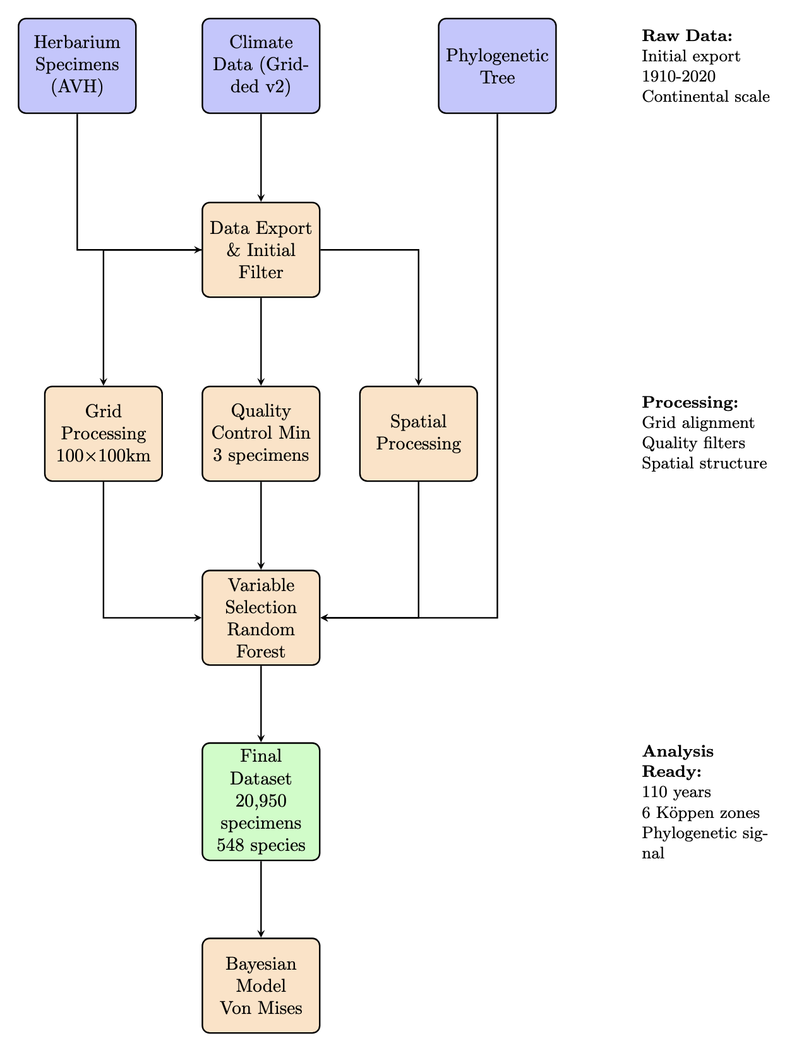
Data preparation workflow
Minimum 3 specimens per species per grid per year
5,259 flowering time estimates after filtering
Climate data alignment with Australian Gridded Climate Data v2
Köppen climate zone boundaries
Phylogenetic tree integration (Ringelberg et al., 2023)
Ringelberg, J. J., Koenen, E. J., Sauter, B., Aebli, A., Rando, J. G., Iganci, J. R., ... & Hughes, C. E. (2023). Precipitation is the main axis of tropical plant phylogenetic turnover across space and time. Science Advances, 9(7), eade4954.
Notes:
Organisations, large and small, capitalise on our solutions as catalysts for growth. Spanning a range of scientific disciplines across the various stages of the innovation lifecycle, we apply our research to inform policy, develop new industries and evolve existing sectors ensuring success into the future.​
​
Sources: https://www.csiro.au/en/work-with-us ​
​
Industry-focused research and development: www.csiro.au/en/work-with-us/services/research-and-development ​
IP and Commercialisation: www.csiro.au/en/work-with-us/ip-commercialisation​
Funding and programs: www.csiro.au/en/work-with-us/funding-programs​
Commercial innovation services: www.csiro.au/en/work-with-us/ip-commercialisation​
Use our labs and facilities: www.csiro.au/en/work-with-us/use-our-labs-facilities​
Global collaboration: www.csiro.au/en/work-with-us/international ​

Slide 29
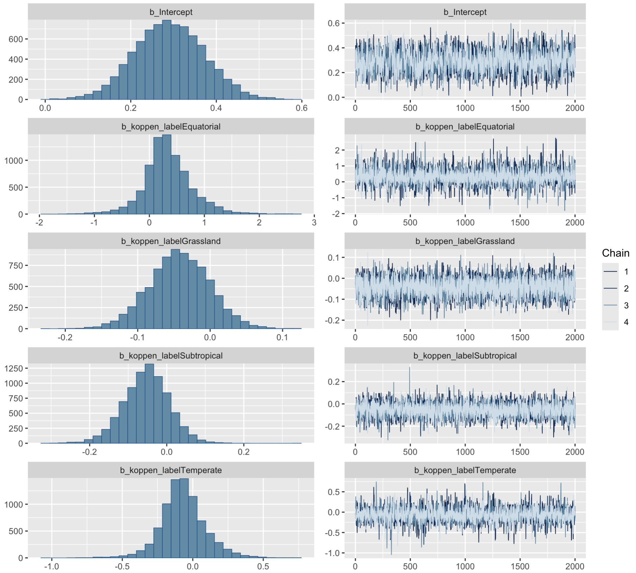
Model Implementation & Diagnostics
Bayesian hierarchical models with {brms} R pkg
Weakly informative priors + plausible initial values to help complex models converge + sample well
Good convergence
All R̂ < 1.01
Effective sample sizes > 1000
Trace plots looked good
Posterior predictive checks confirmed model adequacy
Notes:
Organisations, large and small, capitalise on our solutions as catalysts for growth. Spanning a range of scientific disciplines across the various stages of the innovation lifecycle, we apply our research to inform policy, develop new industries and evolve existing sectors ensuring success into the future.​
​
Sources: https://www.csiro.au/en/work-with-us ​
​
Industry-focused research and development: www.csiro.au/en/work-with-us/services/research-and-development ​
IP and Commercialisation: www.csiro.au/en/work-with-us/ip-commercialisation​
Funding and programs: www.csiro.au/en/work-with-us/funding-programs​
Commercial innovation services: www.csiro.au/en/work-with-us/ip-commercialisation​
Use our labs and facilities: www.csiro.au/en/work-with-us/use-our-labs-facilities​
Global collaboration: www.csiro.au/en/work-with-us/international ​

Slide 30
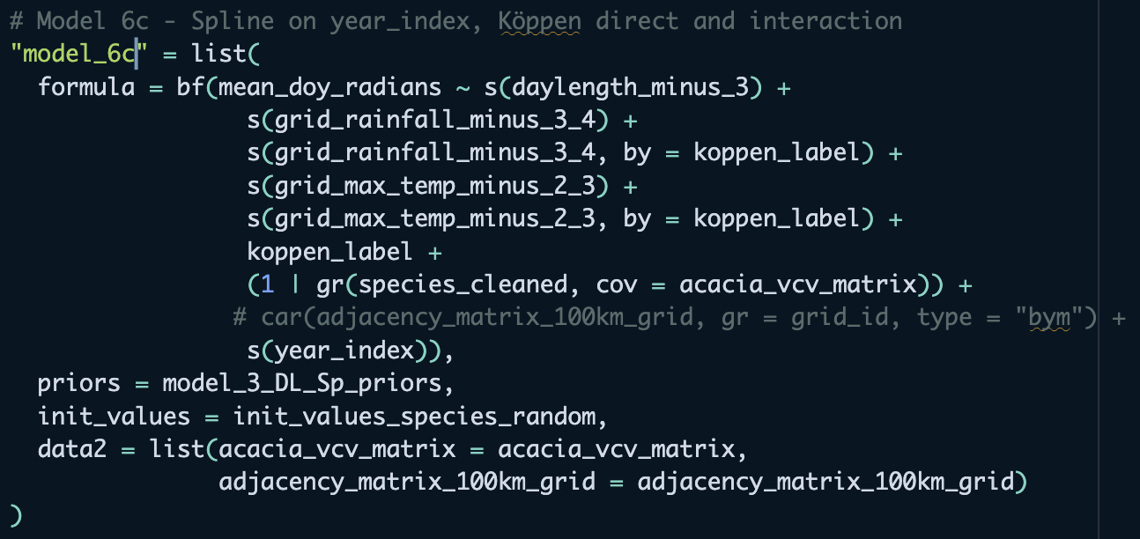
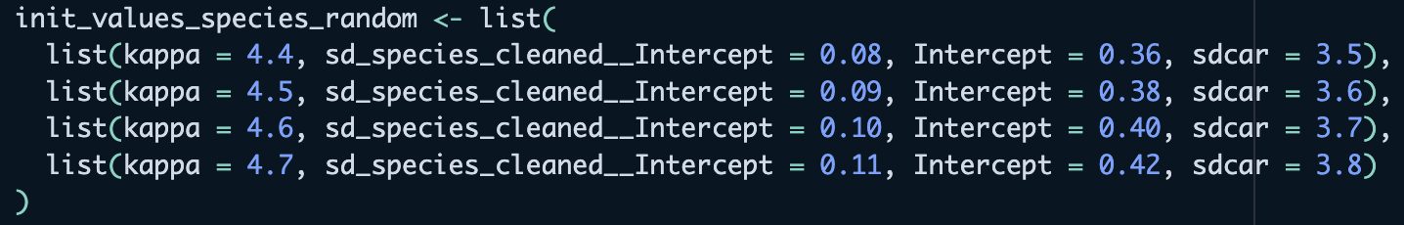
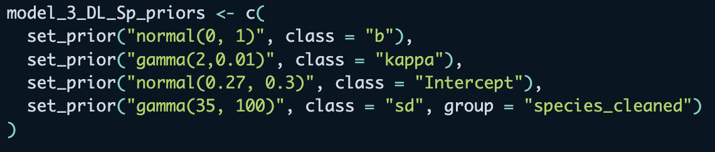
Model Details
Weakly informative priors & plausible initial values selected iteratively to help with convergence
Convergence challenging with complex model structure, circular outcome variable, autocorrelation terms
Remaining step for supplementary materials: prior sensitivity analysis for final main model
Notes:
Organisations, large and small, capitalise on our solutions as catalysts for growth. Spanning a range of scientific disciplines across the various stages of the innovation lifecycle, we apply our research to inform policy, develop new industries and evolve existing sectors ensuring success into the future.​
​
Sources: https://www.csiro.au/en/work-with-us ​
​
Industry-focused research and development: www.csiro.au/en/work-with-us/services/research-and-development ​
IP and Commercialisation: www.csiro.au/en/work-with-us/ip-commercialisation​
Funding and programs: www.csiro.au/en/work-with-us/funding-programs​
Commercial innovation services: www.csiro.au/en/work-with-us/ip-commercialisation​
Use our labs and facilities: www.csiro.au/en/work-with-us/use-our-labs-facilities​
Global collaboration: www.csiro.au/en/work-with-us/international ​

Slide 31
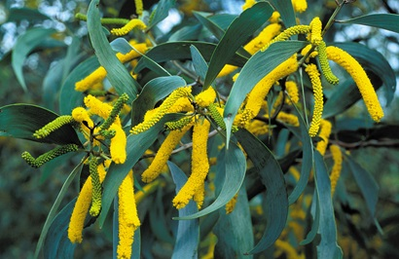
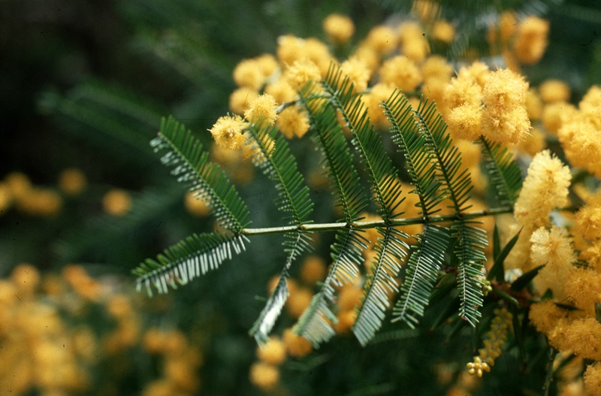
Limitations & Future Directions
Limitations:
• Coarse sensitivity metrics: Fixed increments (2°C, 100mm) don't reflect local variation
• Model not designed to study variation in shape of response between species – requires different data scope + modelling approach
Future Directions:
• Locally-tailored metrics: Scale sensitivity estimates to regional climate variation (CMIP6 projections)
• Expanded taxonomic scope: Apply framework to other plant groups
• Computer vision / ML pipelines to extract reproductive features from herbarium images at scale
Notes:
Organisations, large and small, capitalise on our solutions as catalysts for growth. Spanning a range of scientific disciplines across the various stages of the innovation lifecycle, we apply our research to inform policy, develop new industries and evolve existing sectors ensuring success into the future.​
​
Sources: https://www.csiro.au/en/work-with-us ​
​
Industry-focused research and development: www.csiro.au/en/work-with-us/services/research-and-development ​
IP and Commercialisation: www.csiro.au/en/work-with-us/ip-commercialisation​
Funding and programs: www.csiro.au/en/work-with-us/funding-programs​
Commercial innovation services: www.csiro.au/en/work-with-us/ip-commercialisation​
Use our labs and facilities: www.csiro.au/en/work-with-us/use-our-labs-facilities​
Global collaboration: www.csiro.au/en/work-with-us/international ​

Slide 32
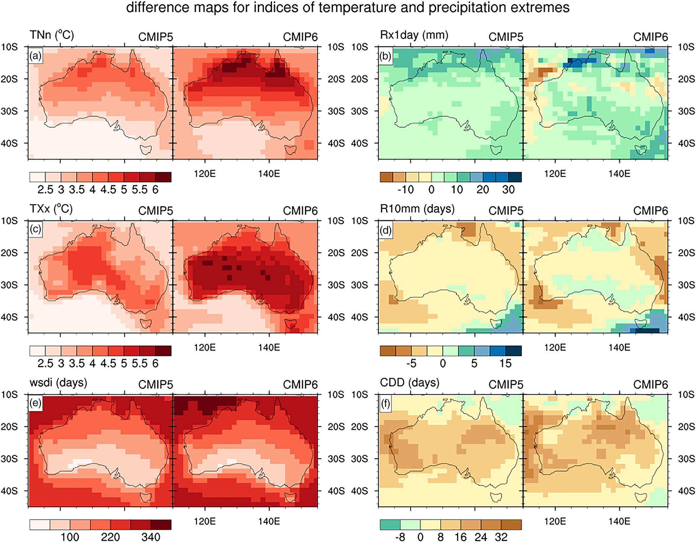
Climate Projections & Forecasting Future Flowering Phenology
Collaboration with Environment RU – Michael Grose & Damien Irving
CMIP6 Climate projections models – regionally scaled & tailored
What are the expected effects of projected changes in rainfall and temperature, across different climate change scenarios and time horizons?
What are the downstream impacts this will have on Australian ecosystems and biodiversity?
https://agupubs.onlinelibrary.wiley.com/cms/asset/20bf6409-5b6d-4115-81b4-0eefff00d804/eft2648-fig-0011-m.jpg

Slide 33
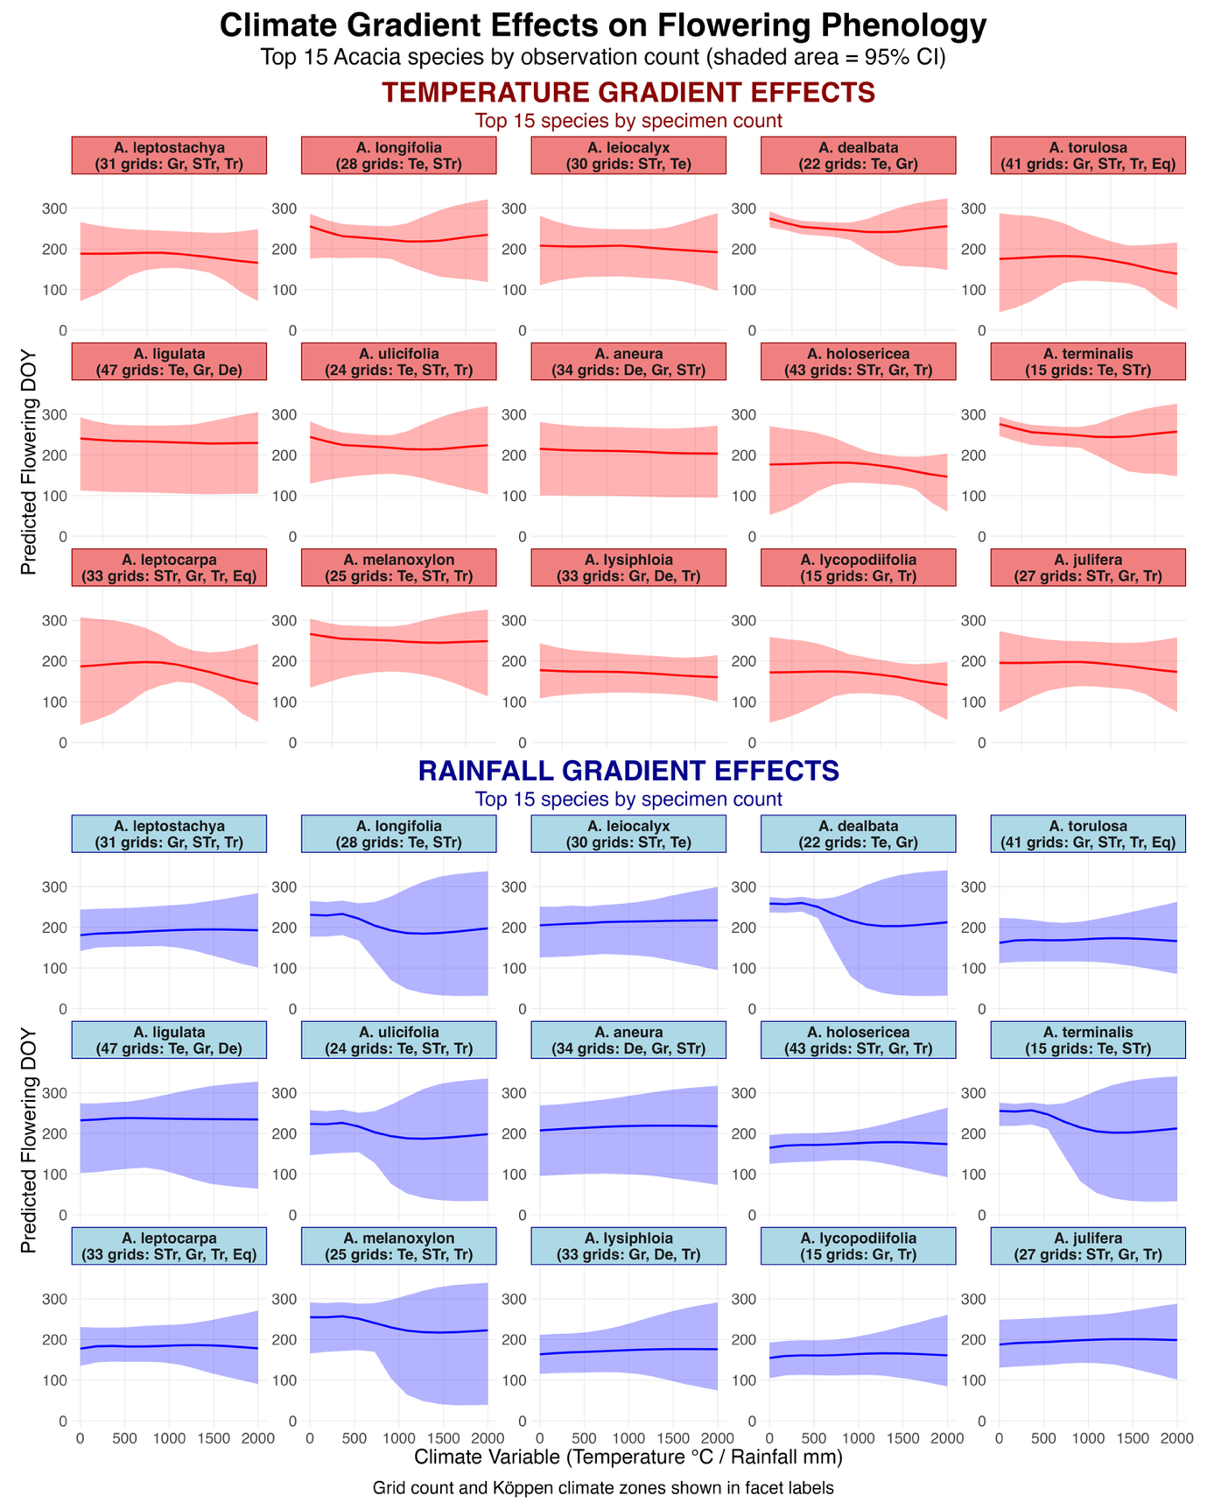
Species-Level Variation
Dramatic Differences Among Species
Temperature: some species expected shift >10 days per 2°C
Rainfall: responses range from -2.6 to +4.6 days per 100mm
Strong phylogenetic clustering of sensitivity
Different species show diverse response patterns
Notes:
Organisations, large and small, capitalise on our solutions as catalysts for growth. Spanning a range of scientific disciplines across the various stages of the innovation lifecycle, we apply our research to inform policy, develop new industries and evolve existing sectors ensuring success into the future.​
​
Sources: https://www.csiro.au/en/work-with-us ​
​
Industry-focused research and development: www.csiro.au/en/work-with-us/services/research-and-development ​
IP and Commercialisation: www.csiro.au/en/work-with-us/ip-commercialisation​
Funding and programs: www.csiro.au/en/work-with-us/funding-programs​
Commercial innovation services: www.csiro.au/en/work-with-us/ip-commercialisation​
Use our labs and facilities: www.csiro.au/en/work-with-us/use-our-labs-facilities​
Global collaboration: www.csiro.au/en/work-with-us/international ​

Slide 34
Phylogenetic Constraints
Evolution Shapes Climate Responses
Clear phylogenetic clustering in sensitivity
Related species show similar climate responses
Significant phylogenetic signal in temperature & rainfall sensitivity measures
Implications for predicting responses in unstudied species
Some lineages particularly responsive
Trait | N_Species | Mean | SD | Range_Min | Range_Max | Blomberg_K | K_P_value | K_Significant
Sensitivity to temperature increase (+2°C average max. temperature, 2-3 months prior to flowering) | 548 | -1.592 | 1.784 | -11.078 | 0.776 | 0.4271 | 0.001 | TRUE
Sensitivity to temperature decrease (-2°C average max. temperature, 2-3 months prior to flowering) | 548 | 1.502 | 1.646 | -0.796 | 12.996 | 0.3885 | 0.001 | TRUE
Sensitivity to rainfall increase (+100mm cumulative rainfall, 3-4 months prior to flowering) | 548 | 1.304 | 0.914 | -2.95 | 4.54 | 0.279 | 0.001 | TRUE
Sensitivity to rainfall decrease (-100mm cumulative rainfall, 3-4 months prior to flowering) | 548 | 0.016 | 1.484 | -5.843 | 7.148 | 0.1978 | 0.025 | TRUE
Notes:
Organisations, large and small, capitalise on our solutions as catalysts for growth. Spanning a range of scientific disciplines across the various stages of the innovation lifecycle, we apply our research to inform policy, develop new industries and evolve existing sectors ensuring success into the future.​
​
Sources: https://www.csiro.au/en/work-with-us ​
​
Industry-focused research and development: www.csiro.au/en/work-with-us/services/research-and-development ​
IP and Commercialisation: www.csiro.au/en/work-with-us/ip-commercialisation​
Funding and programs: www.csiro.au/en/work-with-us/funding-programs​
Commercial innovation services: www.csiro.au/en/work-with-us/ip-commercialisation​
Use our labs and facilities: www.csiro.au/en/work-with-us/use-our-labs-facilities​
Global collaboration: www.csiro.au/en/work-with-us/international ​

Slide 35
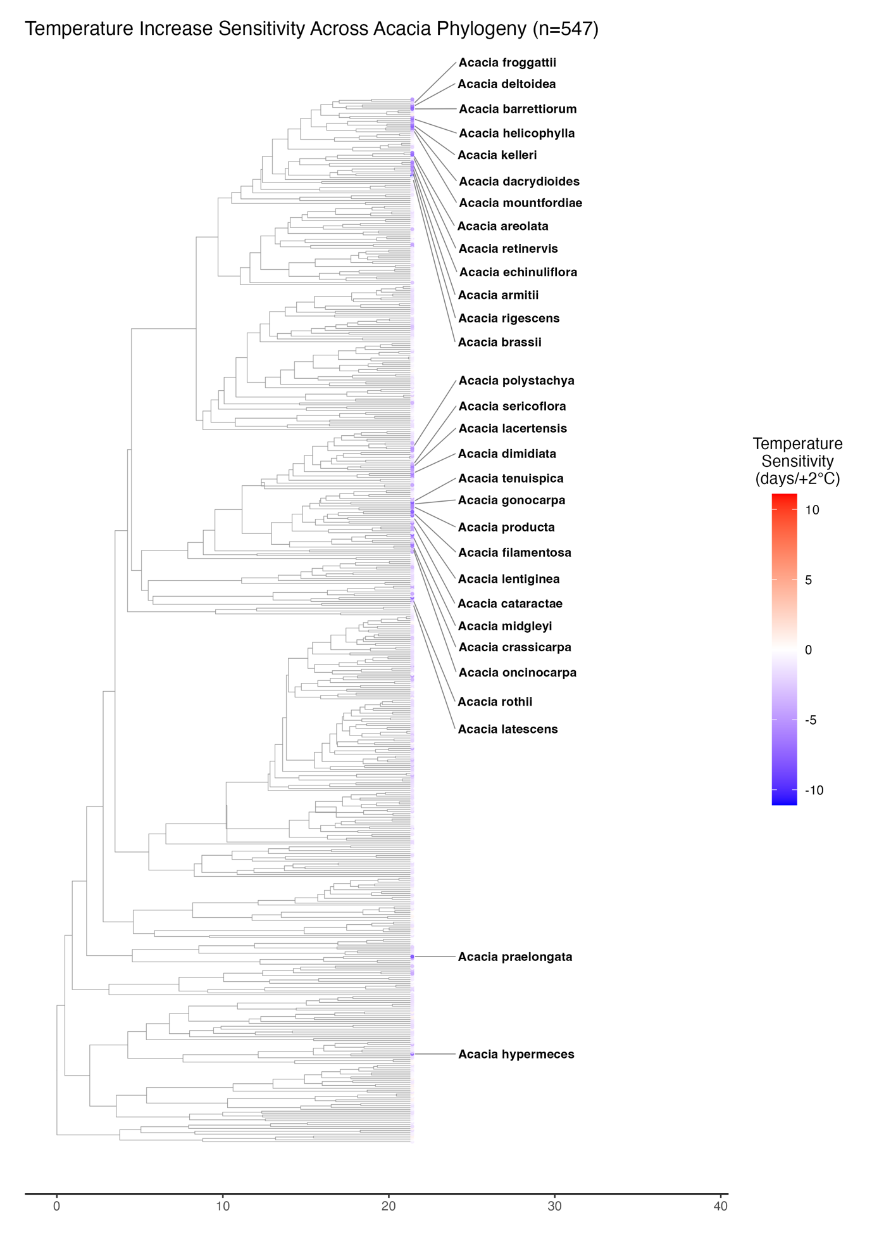
Phylogenetic Constraints
Evolution Shapes Climate Responses
Clear phylogenetic clustering in sensitivity
Related species show similar climate responses
Significant phylogenetic signals in temperature & rainfall sensitivity measures (Blomberg’s K = 0.28 – 0.42)
Implications for predicting responses in unstudied species
Most sensitive species tend to have narrow ranges
Niche breadth-range size relationships (Slatyer et al 2013)
Notes:
Organisations, large and small, capitalise on our solutions as catalysts for growth. Spanning a range of scientific disciplines across the various stages of the innovation lifecycle, we apply our research to inform policy, develop new industries and evolve existing sectors ensuring success into the future.​
​
Sources: https://www.csiro.au/en/work-with-us ​
​
Industry-focused research and development: www.csiro.au/en/work-with-us/services/research-and-development ​
IP and Commercialisation: www.csiro.au/en/work-with-us/ip-commercialisation​
Funding and programs: www.csiro.au/en/work-with-us/funding-programs​
Commercial innovation services: www.csiro.au/en/work-with-us/ip-commercialisation​
Use our labs and facilities: www.csiro.au/en/work-with-us/use-our-labs-facilities​
Global collaboration: www.csiro.au/en/work-with-us/international ​

Slide 36
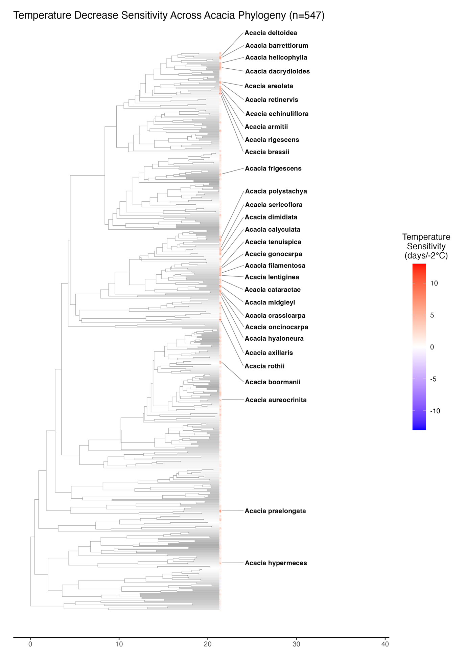
Phylogenetic Constraints
Evolution Shapes Climate Responses
Clear phylogenetic clustering in sensitivity
Related species show similar climate responses
Significant phylogenetic signals in temperature & rainfall sensitivity measures (Blomberg’s K = 0.28 – 0.42)
Implications for predicting responses in unstudied species
Most sensitive species tend to have narrow ranges
Niche breadth-range size relationships (Slatyer et al 2013)
Notes:
Organisations, large and small, capitalise on our solutions as catalysts for growth. Spanning a range of scientific disciplines across the various stages of the innovation lifecycle, we apply our research to inform policy, develop new industries and evolve existing sectors ensuring success into the future.​
​
Sources: https://www.csiro.au/en/work-with-us ​
​
Industry-focused research and development: www.csiro.au/en/work-with-us/services/research-and-development ​
IP and Commercialisation: www.csiro.au/en/work-with-us/ip-commercialisation​
Funding and programs: www.csiro.au/en/work-with-us/funding-programs​
Commercial innovation services: www.csiro.au/en/work-with-us/ip-commercialisation​
Use our labs and facilities: www.csiro.au/en/work-with-us/use-our-labs-facilities​
Global collaboration: www.csiro.au/en/work-with-us/international ​

Slide 37
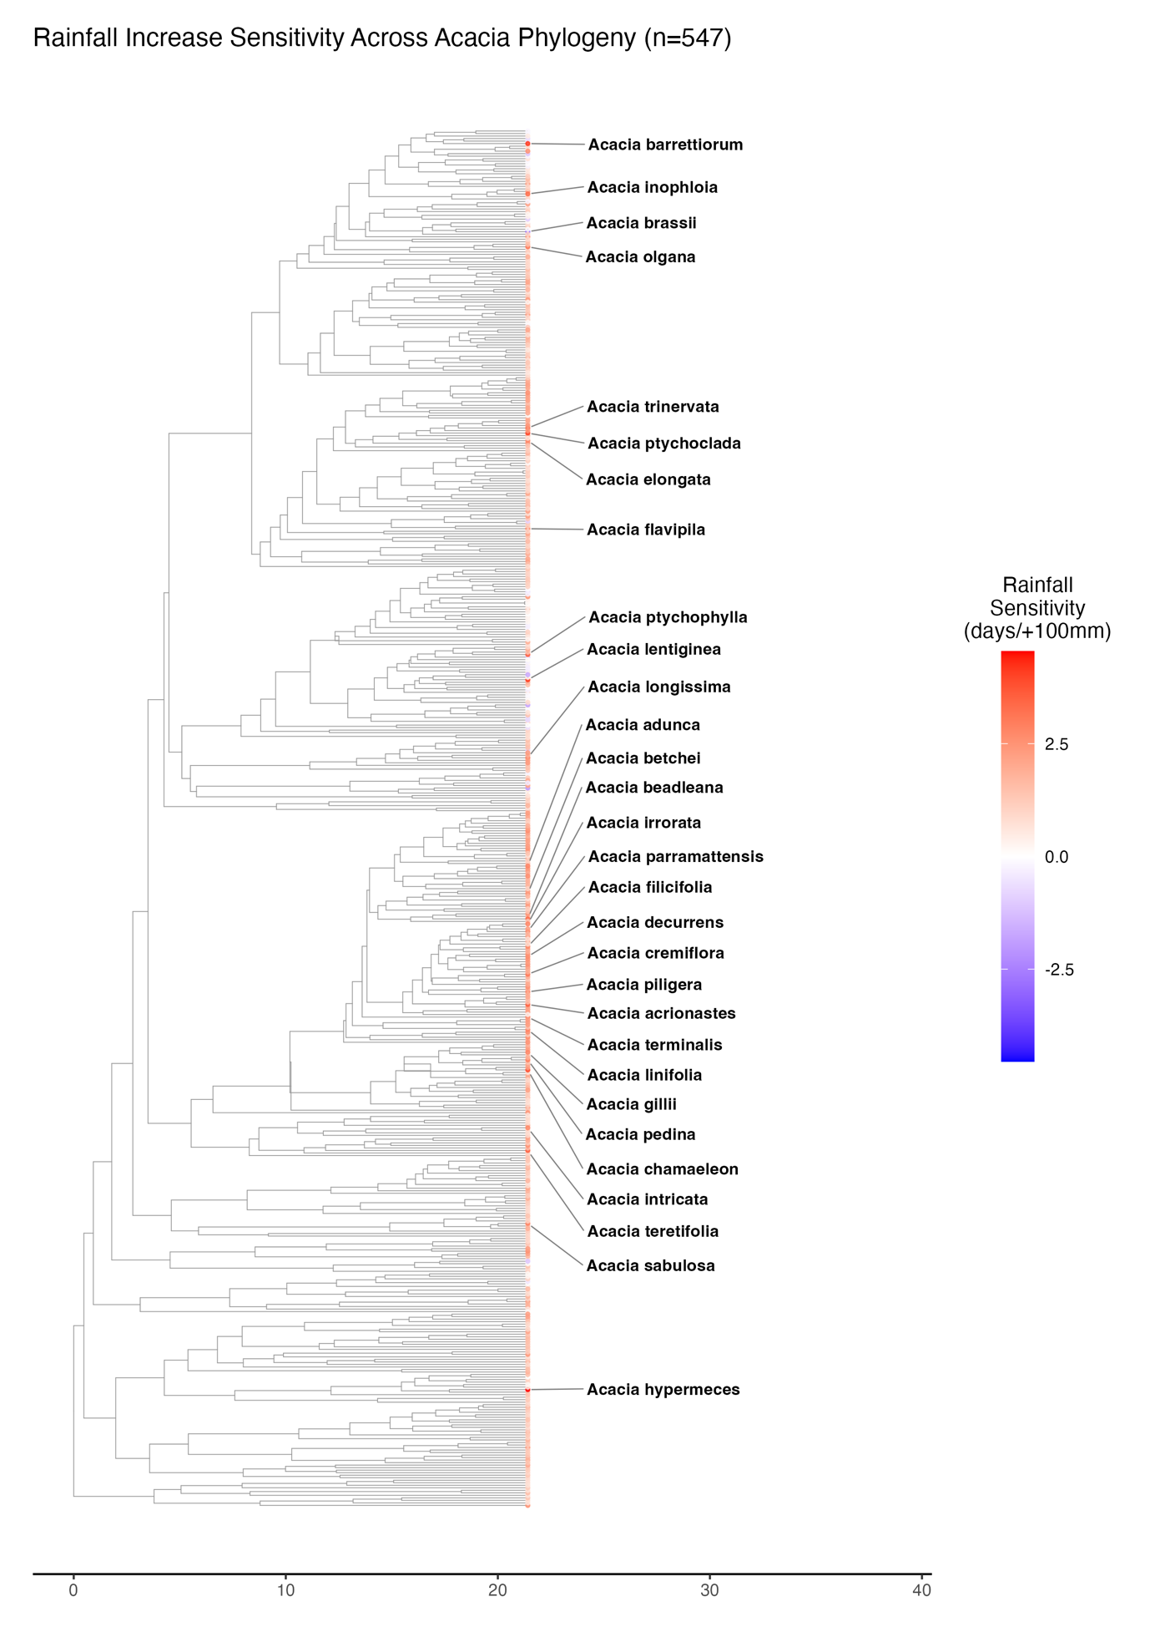
Phylogenetic Constraints
Evolution Shapes Climate Responses
Clear phylogenetic clustering in sensitivity
Related species show similar climate responses
Significant phylogenetic signals in temperature & rainfall sensitivity measures (Blomberg’s K = 0.28 – 0.42)
Implications for predicting responses in unstudied species
Most sensitive species tend to have narrow ranges
Niche breadth-range size relationships (Slatyer et al 2013)
Notes:
Organisations, large and small, capitalise on our solutions as catalysts for growth. Spanning a range of scientific disciplines across the various stages of the innovation lifecycle, we apply our research to inform policy, develop new industries and evolve existing sectors ensuring success into the future.​
​
Sources: https://www.csiro.au/en/work-with-us ​
​
Industry-focused research and development: www.csiro.au/en/work-with-us/services/research-and-development ​
IP and Commercialisation: www.csiro.au/en/work-with-us/ip-commercialisation​
Funding and programs: www.csiro.au/en/work-with-us/funding-programs​
Commercial innovation services: www.csiro.au/en/work-with-us/ip-commercialisation​
Use our labs and facilities: www.csiro.au/en/work-with-us/use-our-labs-facilities​
Global collaboration: www.csiro.au/en/work-with-us/international ​

Slide 38
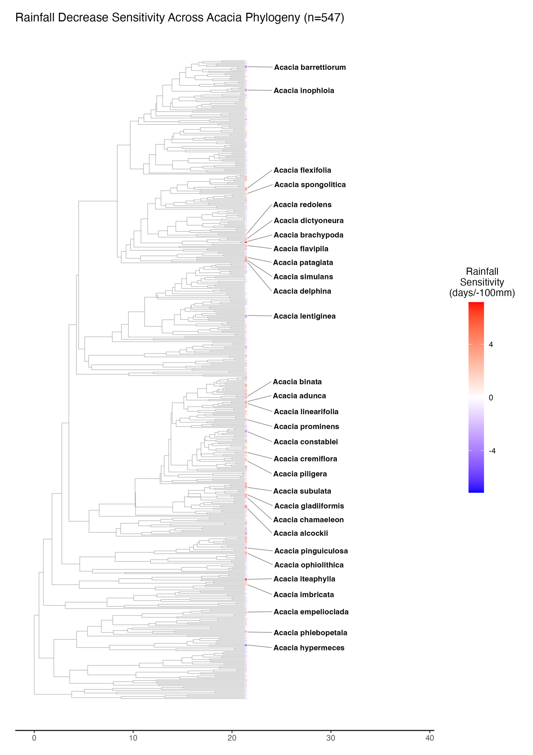
Phylogenetic Constraints
Evolution Shapes Climate Responses
Clear phylogenetic clustering in sensitivity
Related species show similar climate responses
Significant phylogenetic signals in temperature & rainfall sensitivity measures (Blomberg’s K = 0.28 – 0.42)
Implications for predicting responses in unstudied species
Most sensitive species tend to have narrow ranges
Niche breadth-range size relationships (Slatyer et al 2013)
Notes:
Organisations, large and small, capitalise on our solutions as catalysts for growth. Spanning a range of scientific disciplines across the various stages of the innovation lifecycle, we apply our research to inform policy, develop new industries and evolve existing sectors ensuring success into the future.​
​
Sources: https://www.csiro.au/en/work-with-us ​
​
Industry-focused research and development: www.csiro.au/en/work-with-us/services/research-and-development ​
IP and Commercialisation: www.csiro.au/en/work-with-us/ip-commercialisation​
Funding and programs: www.csiro.au/en/work-with-us/funding-programs​
Commercial innovation services: www.csiro.au/en/work-with-us/ip-commercialisation​
Use our labs and facilities: www.csiro.au/en/work-with-us/use-our-labs-facilities​
Global collaboration: www.csiro.au/en/work-with-us/international ​

Slide 39
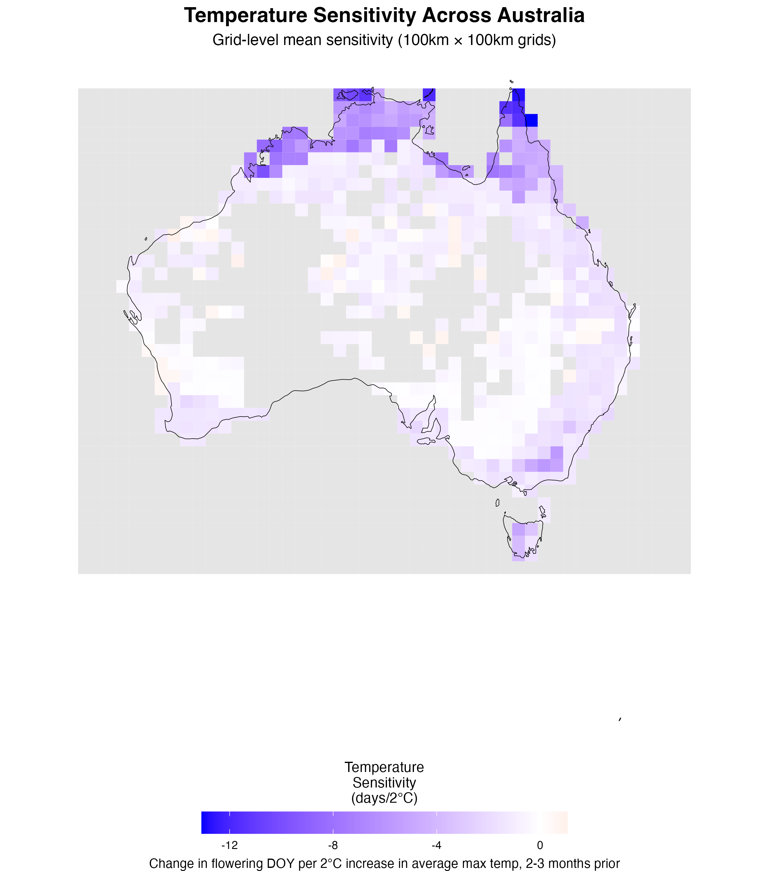
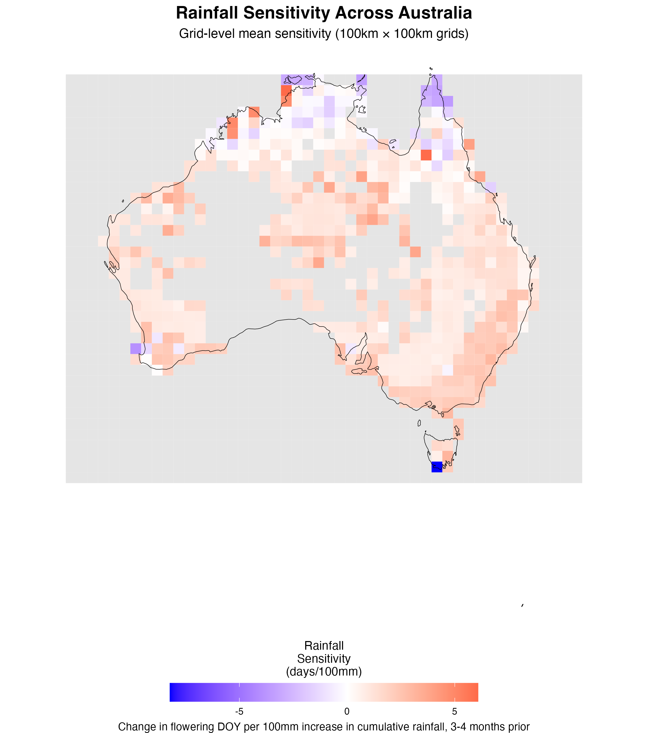
Spatial Patterns in Climate Sensitivity
Notes:
Organisations, large and small, capitalise on our solutions as catalysts for growth. Spanning a range of scientific disciplines across the various stages of the innovation lifecycle, we apply our research to inform policy, develop new industries and evolve existing sectors ensuring success into the future.​
​
Sources: https://www.csiro.au/en/work-with-us ​
​
Industry-focused research and development: www.csiro.au/en/work-with-us/services/research-and-development ​
IP and Commercialisation: www.csiro.au/en/work-with-us/ip-commercialisation​
Funding and programs: www.csiro.au/en/work-with-us/funding-programs​
Commercial innovation services: www.csiro.au/en/work-with-us/ip-commercialisation​
Use our labs and facilities: www.csiro.au/en/work-with-us/use-our-labs-facilities​
Global collaboration: www.csiro.au/en/work-with-us/international ​

